Slide 1
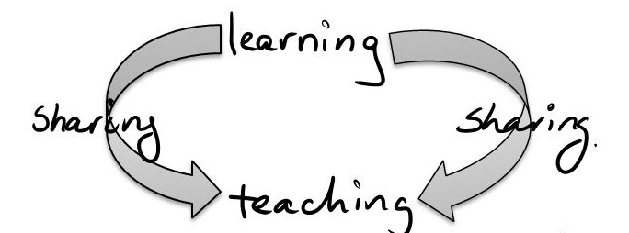
  We learn and share knowledge
To help US grow

Slide 2
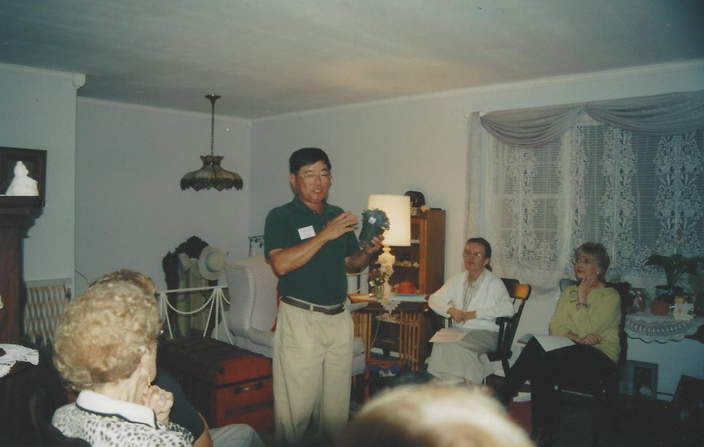
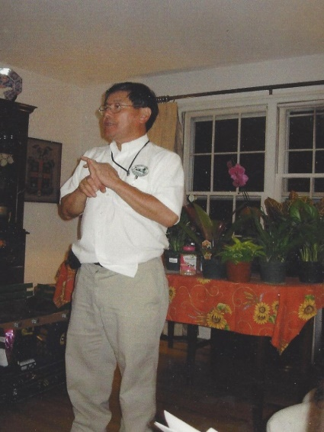
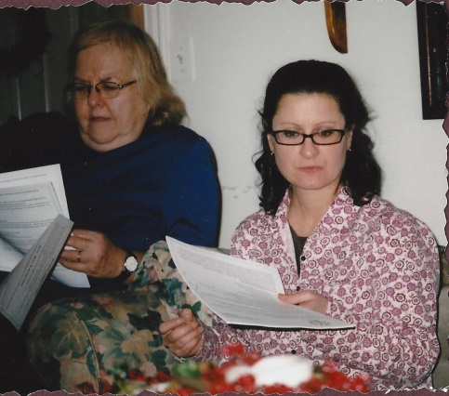
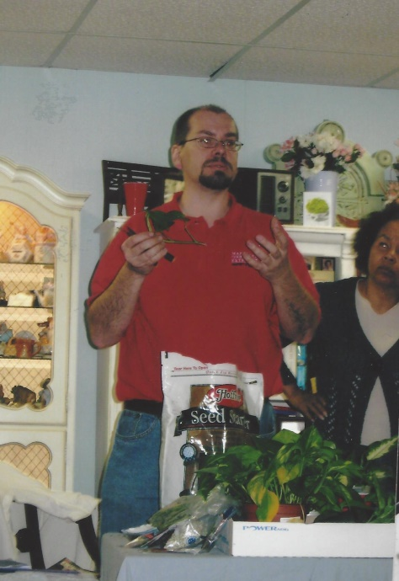
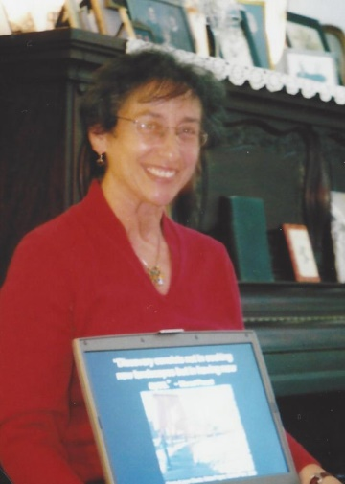
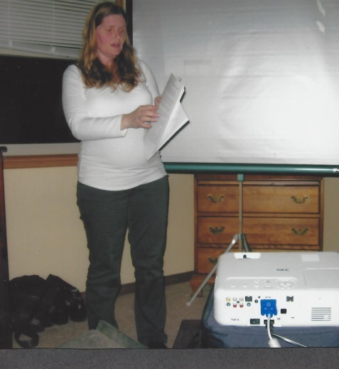
  We learn from others
“Native Plants” by
Marie Arnold
Gardening Advice from Gene Sumi
“Propagation” by Brian Clark
“Bats and Owls” by Betty Akers
“Landscape Design Basics” by Cheryl Corson

Slide 3
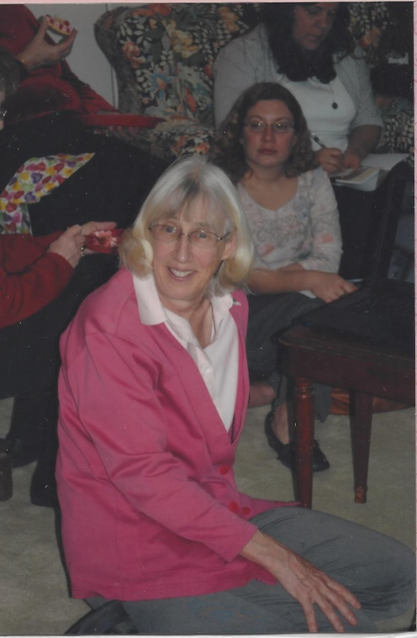
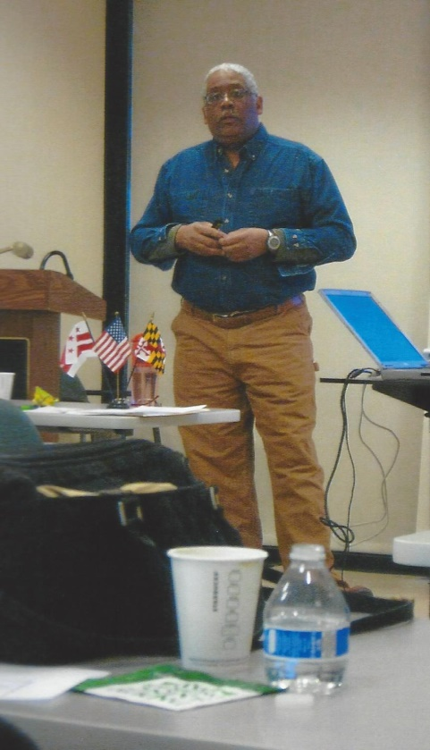
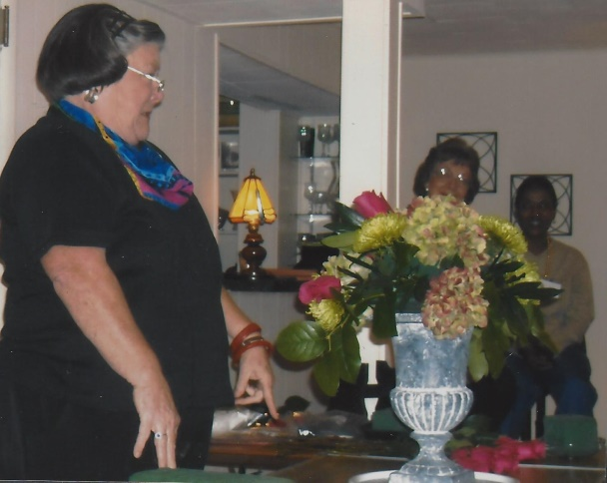
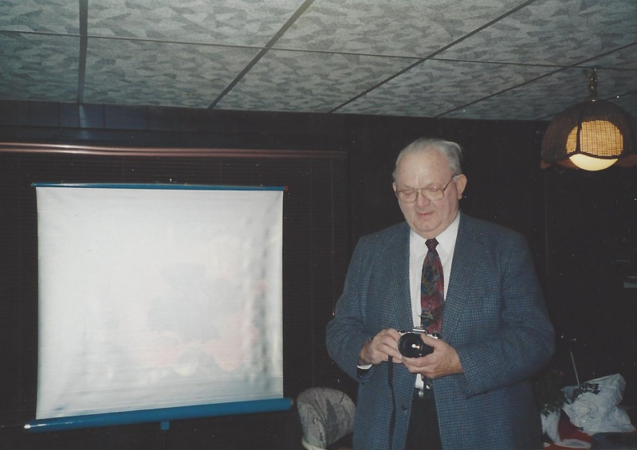
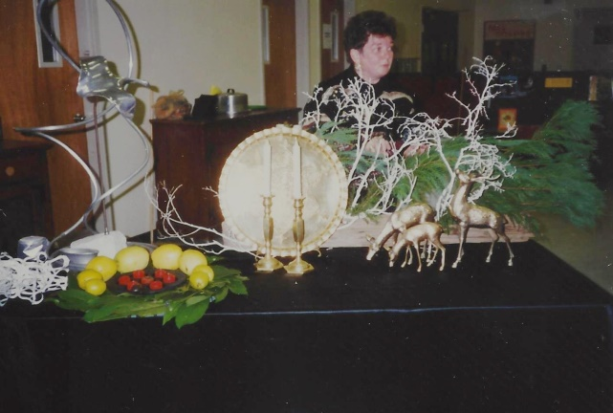
  We learn from others
“Fungi” by Any Rossman
“Floral Design” by Mary Sims
“Flower Photography” by Clayton Werner
“Riverkeeper” by Frederick Tutman
“Holiday Arrangements” by Jo Ann Chapman

Slide 4
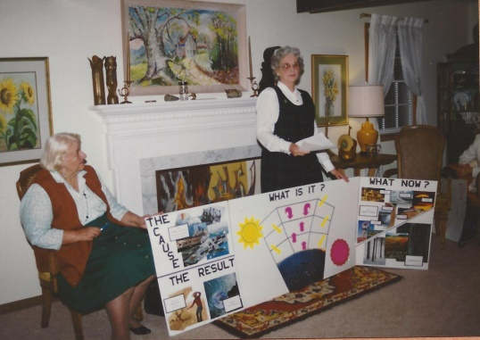
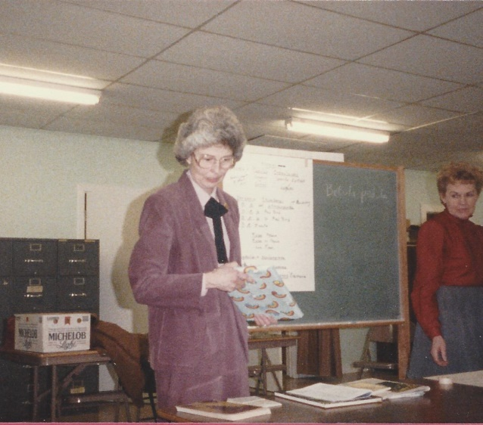
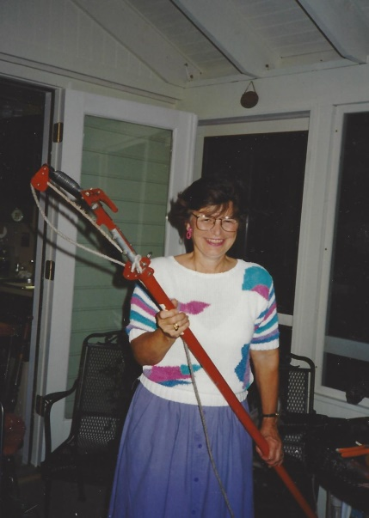
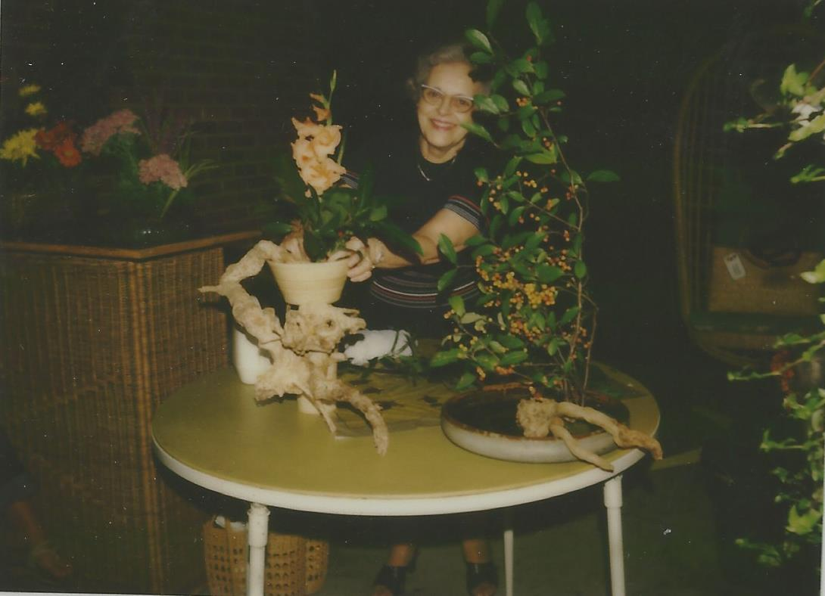
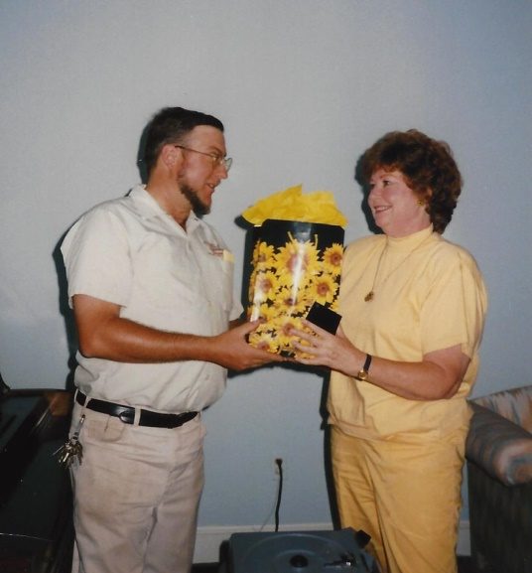
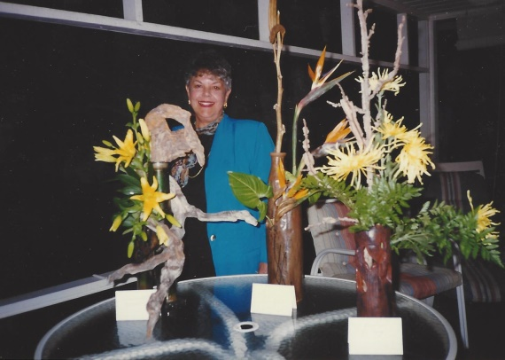
  We learn from others
“Taxonomy” by Donna Sampson
“Pruning” by Audrey Whitney
“Environmental Program” by Joan Bragdon
“Favorite Perennials” by John Peter Thompson
“Japanese Flower Arranging” by Mrs Paul Todd
“Creative Designs” by Beverly Stearns

Slide 5
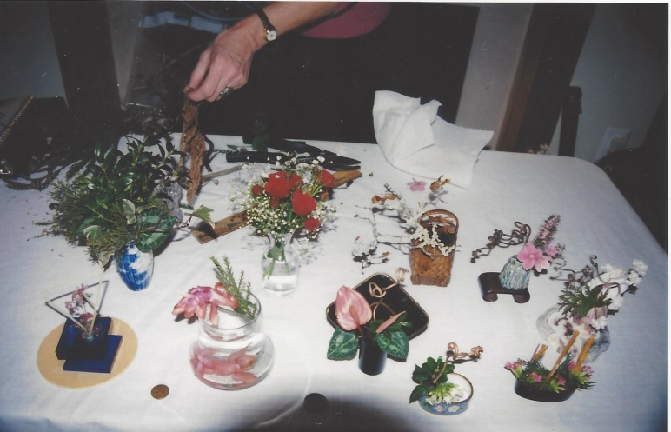
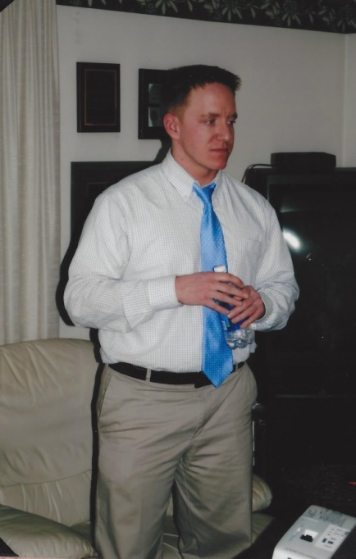
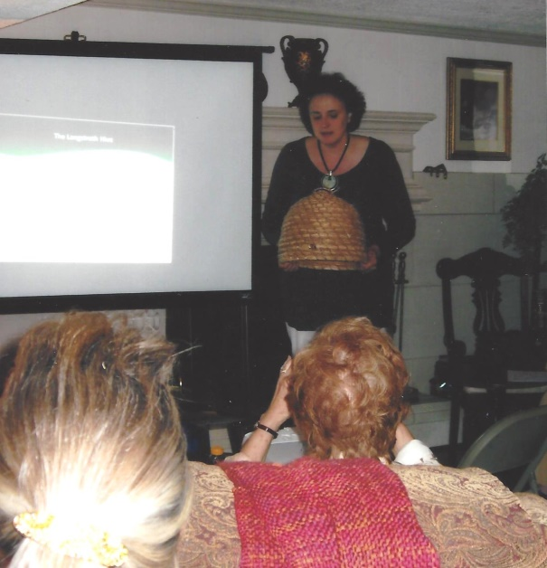
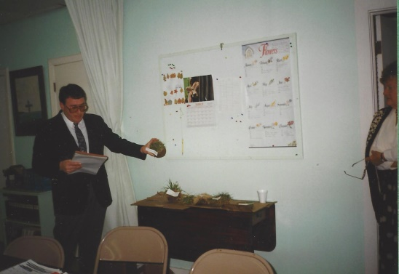
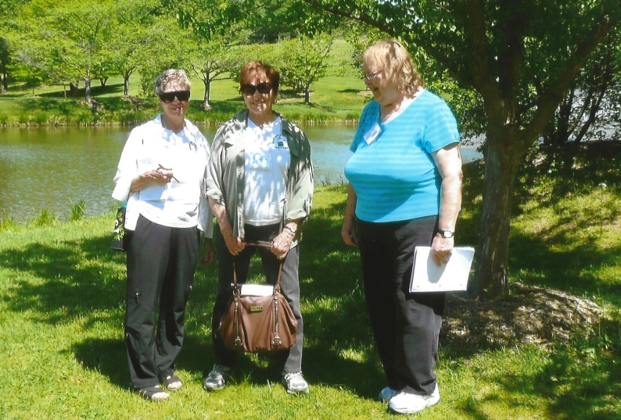
  We learn from others
“Chesapeake Bay Update” by Matt Robinson
“Using Miniature Arrangements” by Ingrid Swann
“Bees” by Toni Burnham
“Getting Down to Grass Roots” by Steven Nash
NCAGC Gardening School

Slide 6
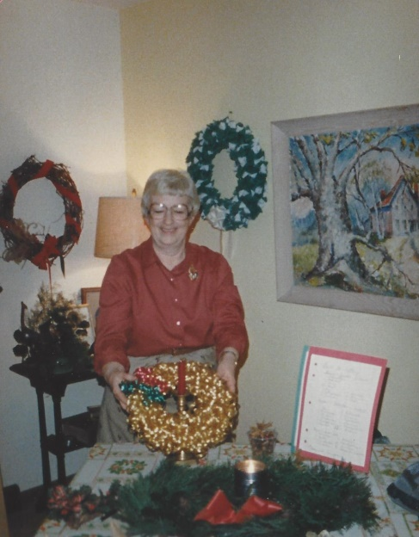
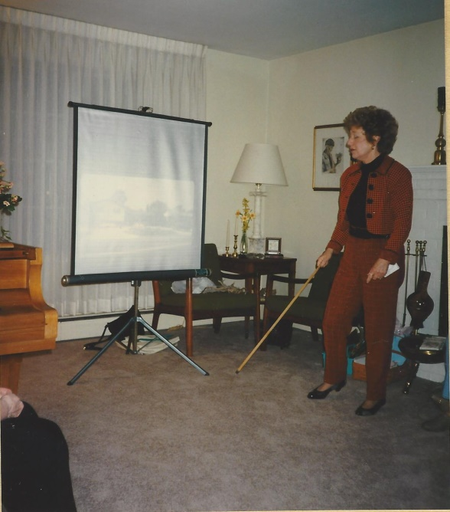
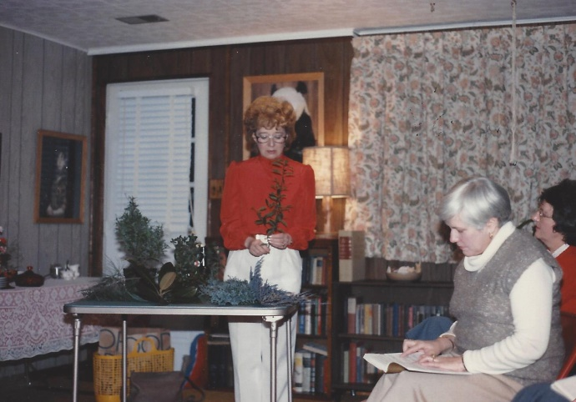
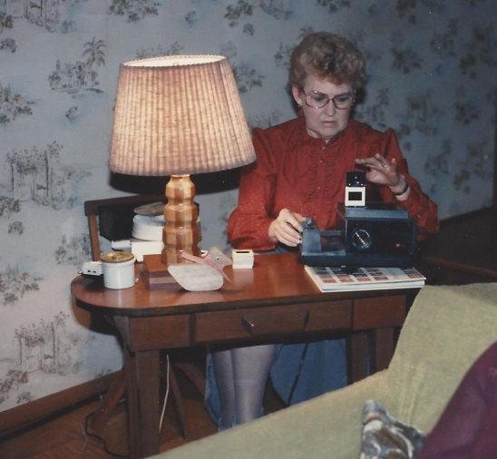
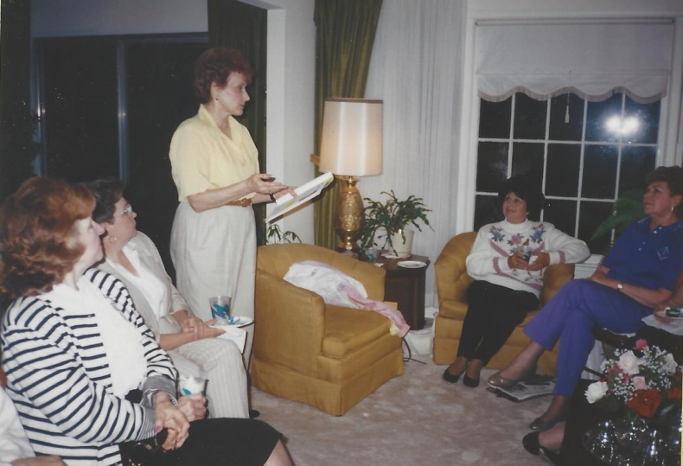
  We share our Knowledge
“Christmas Ideas” by
Ann Williams
“Horticulture for Show & Landscape Design” by Joyce Meyer
“International Designs” by Peg Martin
“Attracting Birds” by
Julie Harrison

Slide 7
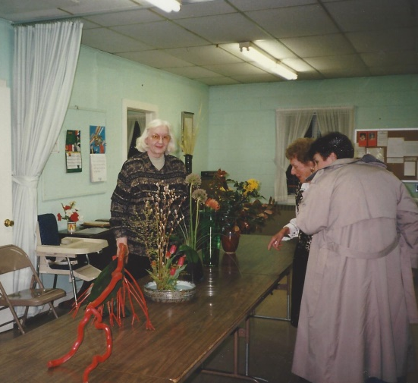
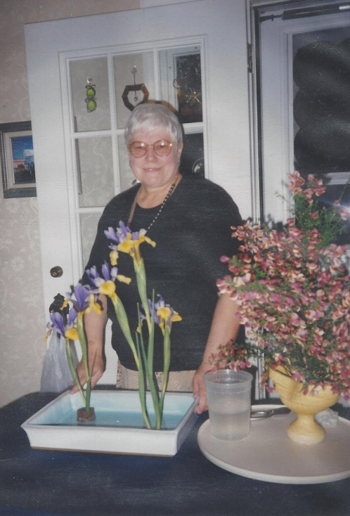
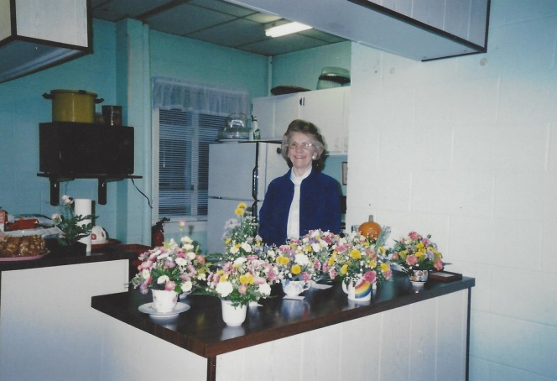
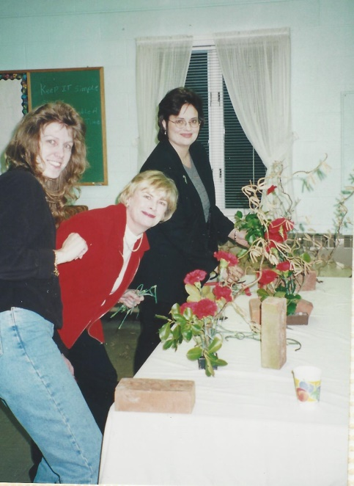
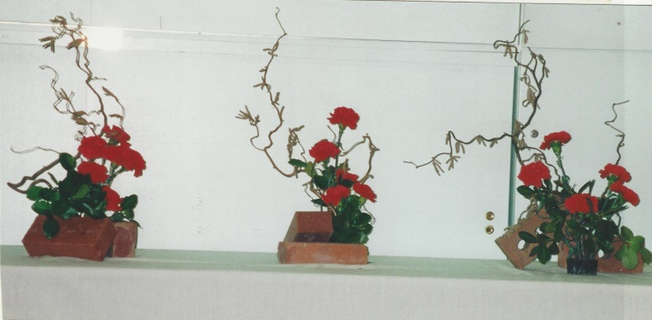
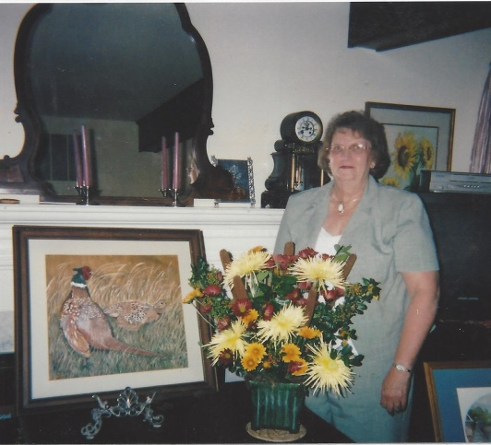
  We share our Knowledge
“Design Program” by Madge Overly
“Challenge to Creativity” by Anne DeBoeser
“Fundamentals of Design using Teacups” by
Marian Moreland
“A Floral Design Complementing Art” by
Dot Lower
“Design Challenge Using Bricks”
by Anne DeBoeser

Slide 8
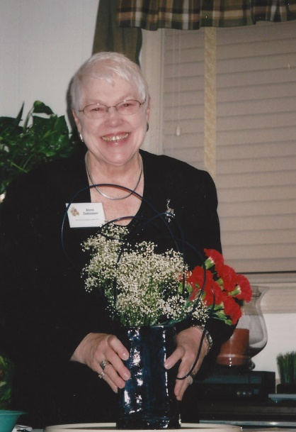
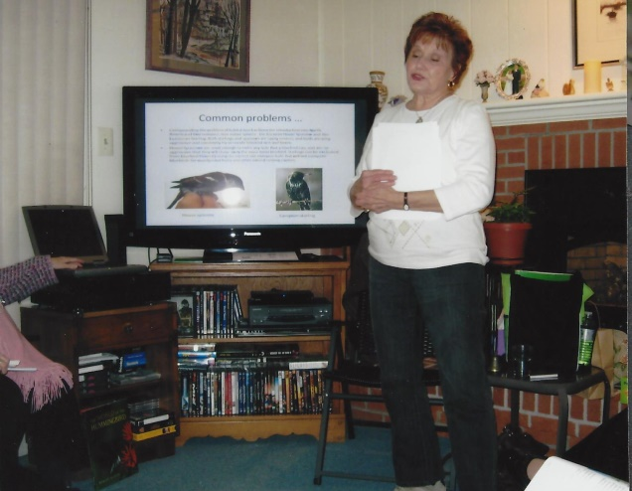
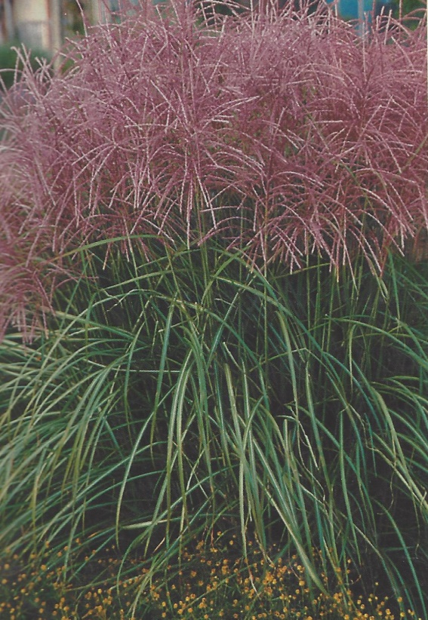
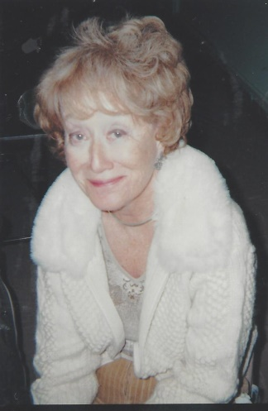
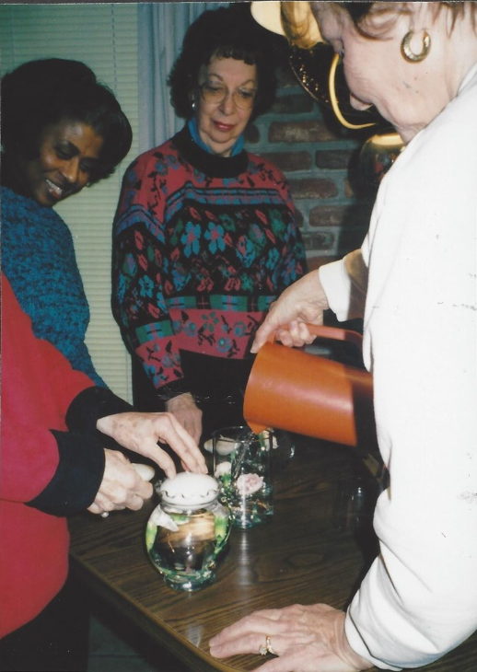
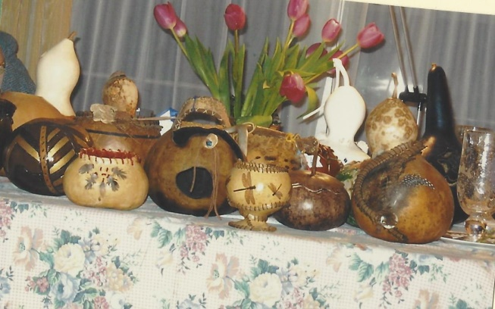
  We share our Knowledge
“Ikebana” by
Anne DeBoeser
“Bluebirds and Hummingbirds” by
Julie Harrison
“Ornamental Grasses” by Joyce Meyer
“Gourds” by Pam Smart
“Arrangements Under Water” by
Julie Harrison

Slide 9
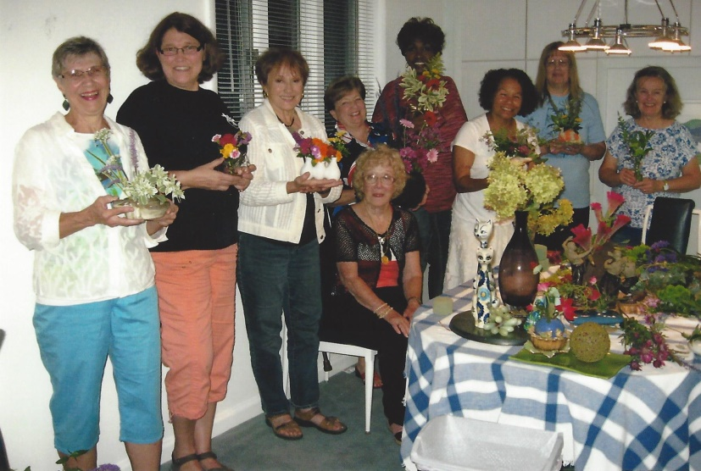
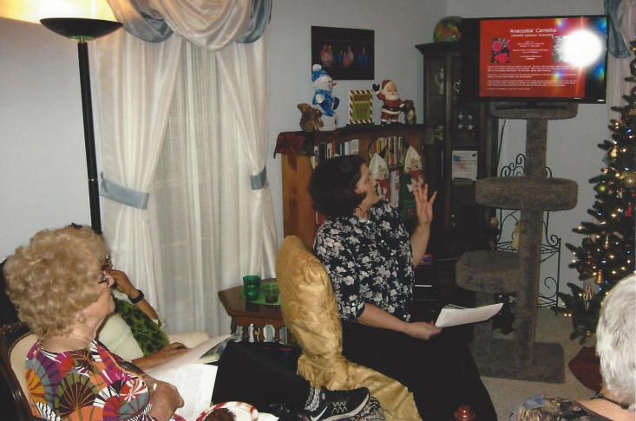
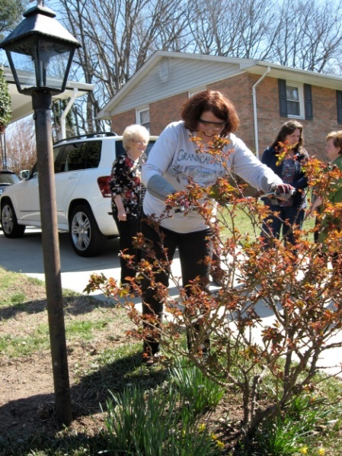
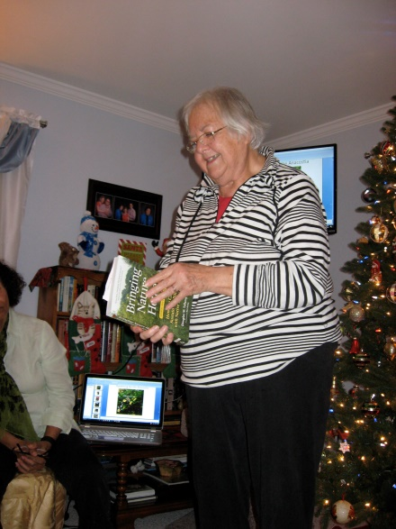
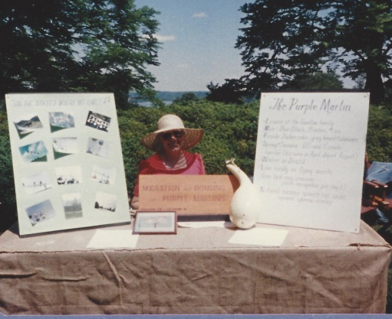
  We share our Knowledge
“Plants we Love” by Deborah Determan
“Flower Design in a Container” by Joyce Meyer
Purple Martin Exhibit by Betty Abercrombie
“Pruning” by
Deborah Determan
Horticulture by
Diana Morse

Slide 10
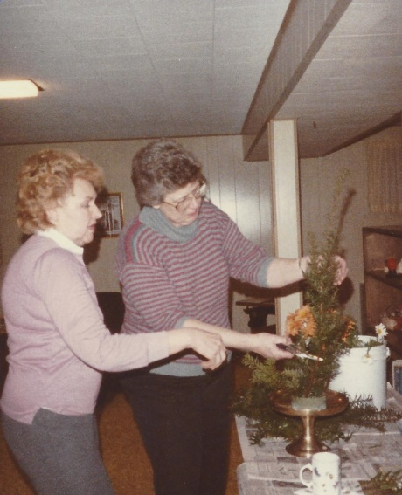
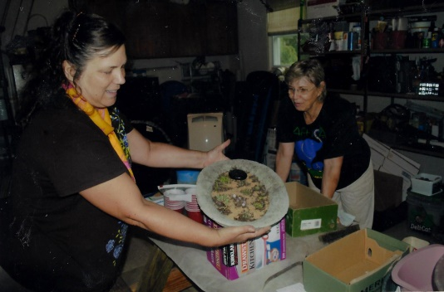
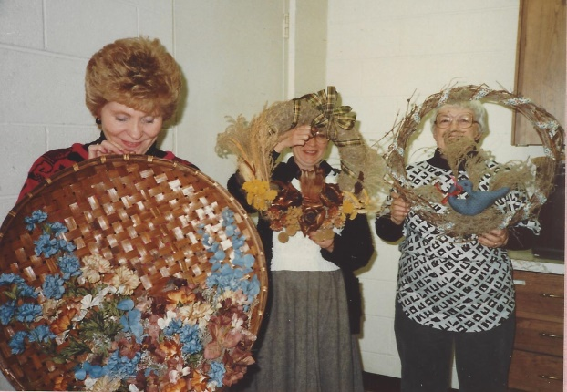
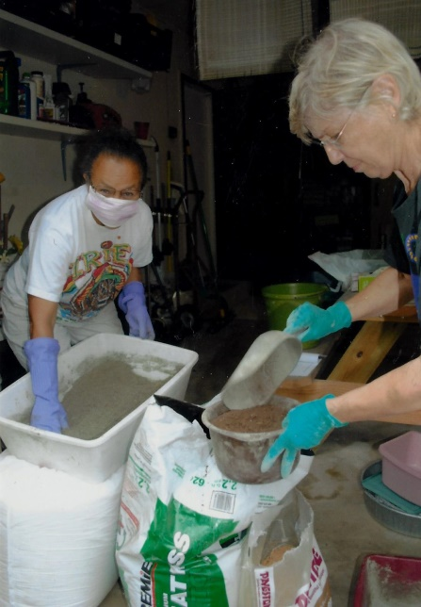
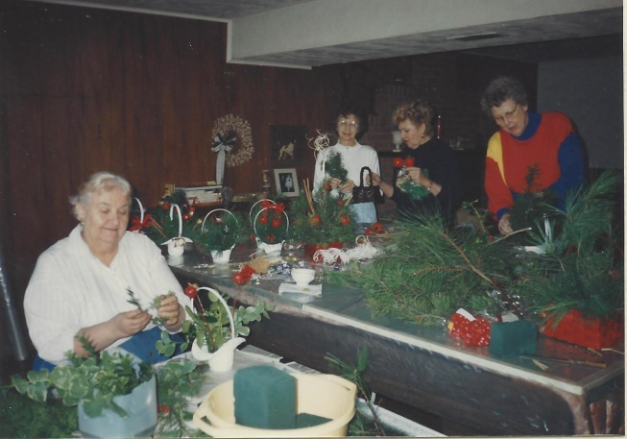

  Workshops
1986-1987
Making Holiday Wreaths
1983-1984
Floral Arranging
2003-2004
Making Hypertufas
Mary Beth Cecil & Lorraine Leonard
2012-2013
Making Hypertufas Lenay O’Quinn
1992-1993
Workshop for Christmas Bazaar

Slide 11






  Workshops
2012-2013
Stepping Stones
Pam Smart
2013-2014
Stepping Stones
Lenay O’Quinn
2016-2017
Leaf Casting
Lenay ‘Quinn

Slide 12


We Have contests

Slide 13











We Have contests
Tomato Size and Quality
Creative Packages
Christmas Candle Arrangements
Ornaments using Natural Materials
Doorknobs
Container Contests
Greeting Cards
Mug Contests

Slide 14





Winners often get ribbons or a silver tray
2009-2010
Mary Jane Bishop Ribbon and Silver Tray Winner
1997-1998
Peg Martin 1st Presentation of Silver Tray
awarded to Marilyn Berkut
2009-2010
Horticulture & Tea Cup Contests
Joyce Meyer and Anne DeBoeser – Our Flower Show Judges

Slide 15



We get out and about

Slide 16





We get out and about
1979-1980
First Tour to Brookside Gardens
1984-1985
Stillridge Herb Farm
1984-1985
Philadelphia Flower Show
1984-1985
Tour Private Gardens Philadelphia
1982-1983
Mormon Temple Grounds

Slide 17





We get out and about
1986-1987
Marshland Ecology Tour Jug Bay
1985-1986
Mount Airy
1988-1989
Cypress Swamp

Slide 18




We get out and about
1992-1993
Benhke Garden Daylily Tour
1990-1991
Londontown Public House and Gardens
1996-1997
Behnke Pointsettia Display

Slide 19




We get out and about
2005-2006
Christmas Holiday Tour Homestead Gardens
2005-2006
Red Chimney Farm

Slide 20




We get out and about
2008-2009
Pica House Gardens and Gift Shop Annapolis
2008-2009
Londontown Gardens

Slide 21





We get out and about
2008-2009
William Brown House
2009-2010
His Lordships Kindness
2009-2010
Cheverly Green Home and Garden Tour

Slide 22





We get out and about
2010-2011
Howard Peters Rawlings Conservatory Botanic Garden
2010-2011
International Flower Show
2010-2011 Jug Bay

Slide 23





We get out and about
2010-2011
Royal Tea Room Holiday Tea
2012-2013
Anne DeBoeser hosted trip to Taylor Greenhouse and lunch

Slide 24



We get out and about
2013-2014
Hillwood Gardens
2014-2015
Soleado Lavender Farm

Slide 25


We Have Club projects

Slide 26




Holloway Gardens
Entrance gardens
At the Beginning
1982-1983
At the Beginning
1982-1983
Breaking the Clay
Before
Planting a Kousa Dogwood
Finished Garden

Slide 27





Holloway Gardens
Entrance gardens
Progress through the Years
Progress through the Years
1993-1994
1987-1988
1995-1996 Work Party
1991-1992 Kousa Dogwood

Slide 28



Holloway Gardens
Entrance gardens
Progress through the Years
Progress through the Years
1996-1997

Slide 29





Holloway Gardens
ENTRANCE GARDENS
Progress through the Years
Progress through the Years
1997-1998
1999-2000
2001-2002
Fall Clean Up
2000-2001
Fall Clean Up

Slide 30




Holloway Gardens
ENTRANCE GARDENS
Progress through the Years
Progress through the Years
2006-2007
2008-2009
2010-2011

Slide 31



Holloway Gardens
ENTRANCE GARDENS
Progress through the Years
Progress through the Years
2013-2014
2013-2014
2013-2014

Slide 32


Holloway Gardens
ENTRANCE GARDENS
Progress through the Years
Progress through the Years
TODAY

Slide 33
Holloway Gardens
Entrance gardens
1982-1983

Slide 34
Holloway Gardens
Entrance gardens
1999-2000

Slide 35
Holloway Gardens
Entrance gardens
1996-1997

Slide 36
Holloway Gardens
Entrance gardens
2008-2009

Slide 37
Holloway Gardens
Entrance gardens
2013-2014

Slide 38


Holloway Gardens
Entrance gardens
1982-1983
1987-1988
2016-2017

Slide 39






Holloway Gardens
Memorials
Roger Neilan Loyal Friend of Clay Breakers
1988-1989 Roger Neilan Memorial
1997-1998 Memorial Bench Marie White

Slide 40




Holloway Gardens
EDGE OF THE WOODS GARDEN
In the beginning 1982-1983
1992-1993

Slide 41







Concordia Lutheran church
2010-2011
Children’s Pizza Garden
2012-2013
Gilda Allen teaching about Butterflies
2012-2013
Planting the Butterfly Garden

Slide 42


Concordia Lutheran church
2010-2011
Concordia Entrance Garden

