Slide 1

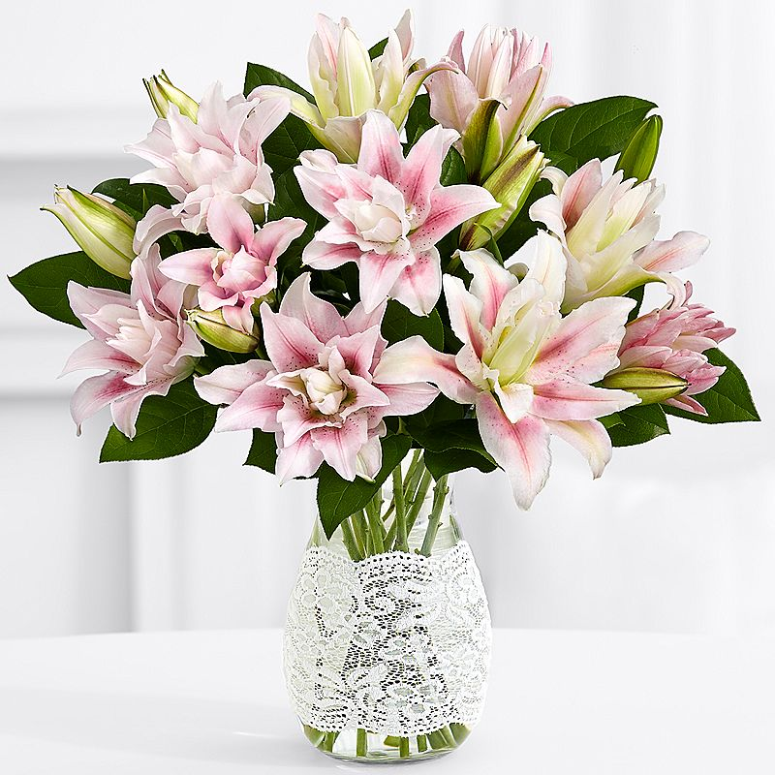
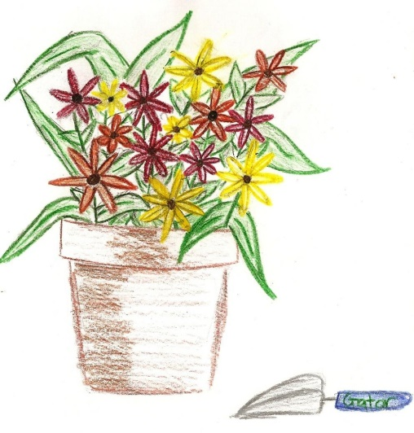
Mount Airy
Clay Breakers
Garden Club
1977 - 2017
Celebrating
40 Years

Slide 2
Who are we and what do we do?
We honor lost friends
We serve our club – our Presidents lead the way
We participate in meetings and club activities to enhance our membership
  We serve as hostess’ for our meetings and enjoy good food
  We create in many ways (tables, media, flower arranging)
  We learn and share knowledge
  We have contests
We get out and about
We have club projects
We tour gardens
We volunteer
We participate in shows
We fundraise
We receive recognition
We are active in the District and the National Capital Area Garden Clubs
We celebrate

Slide 3
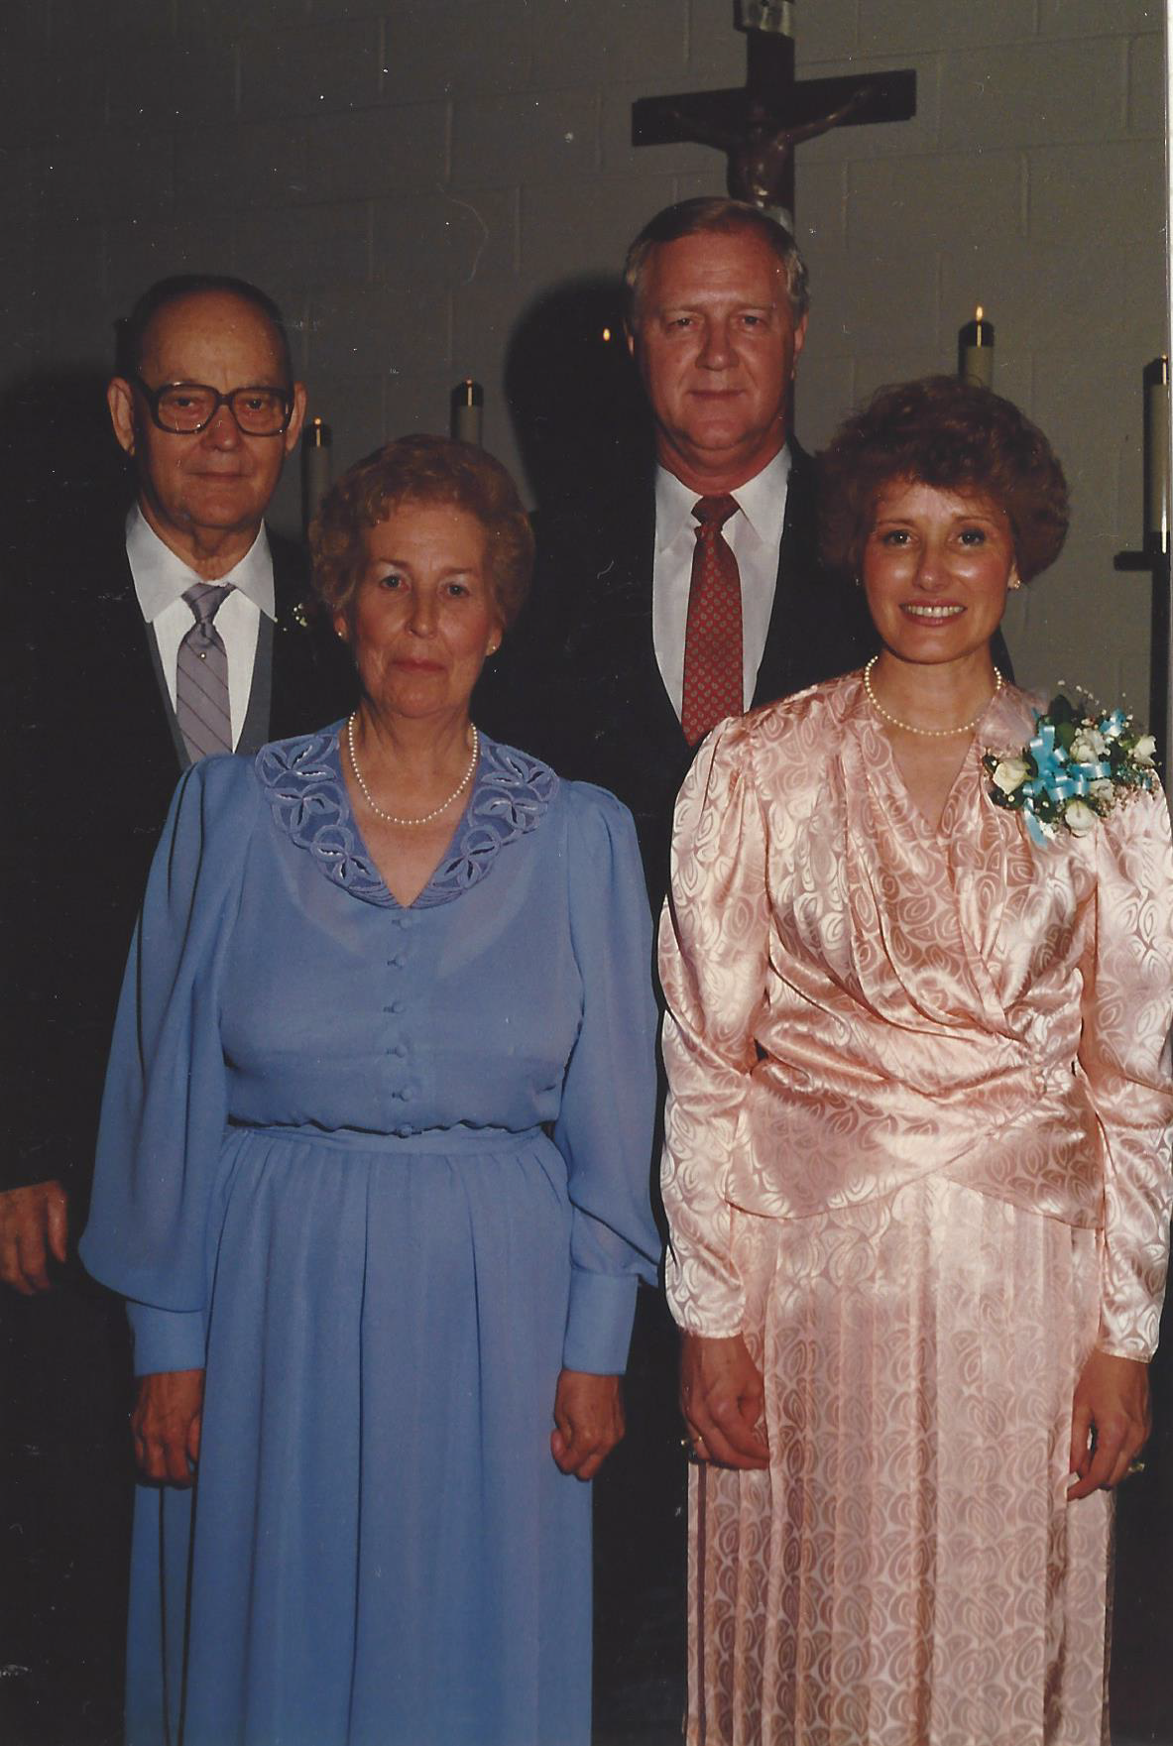
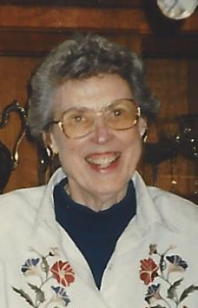
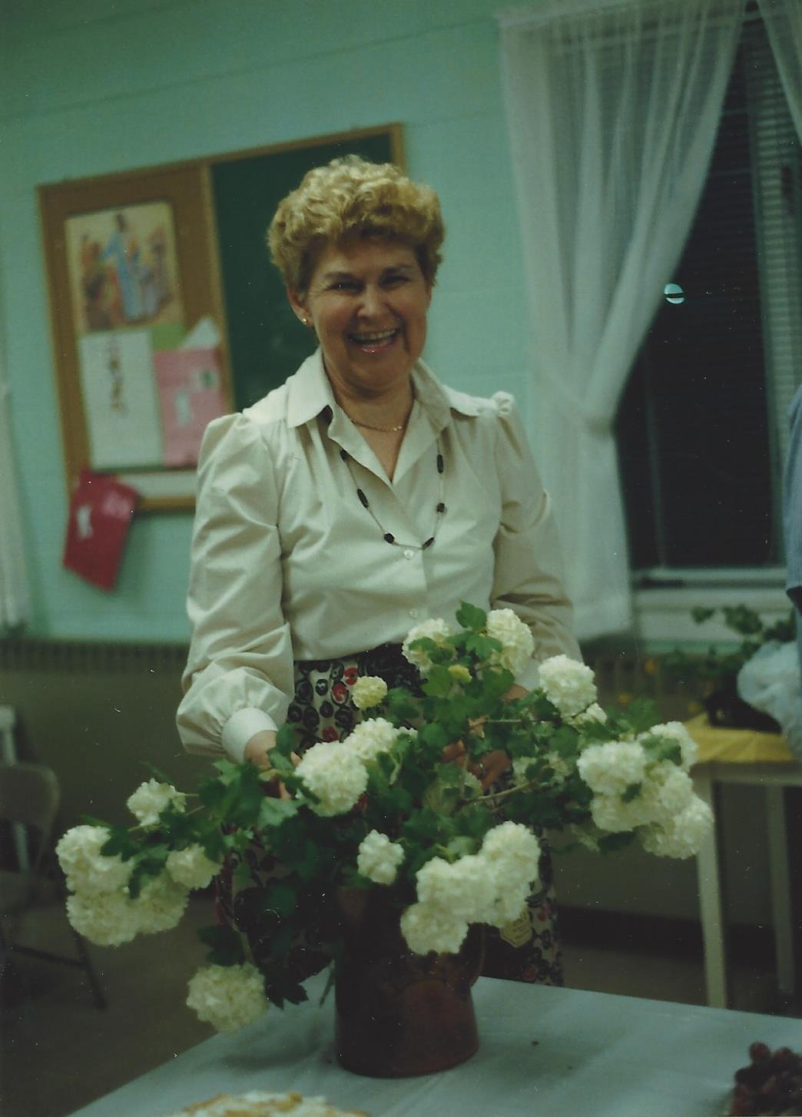
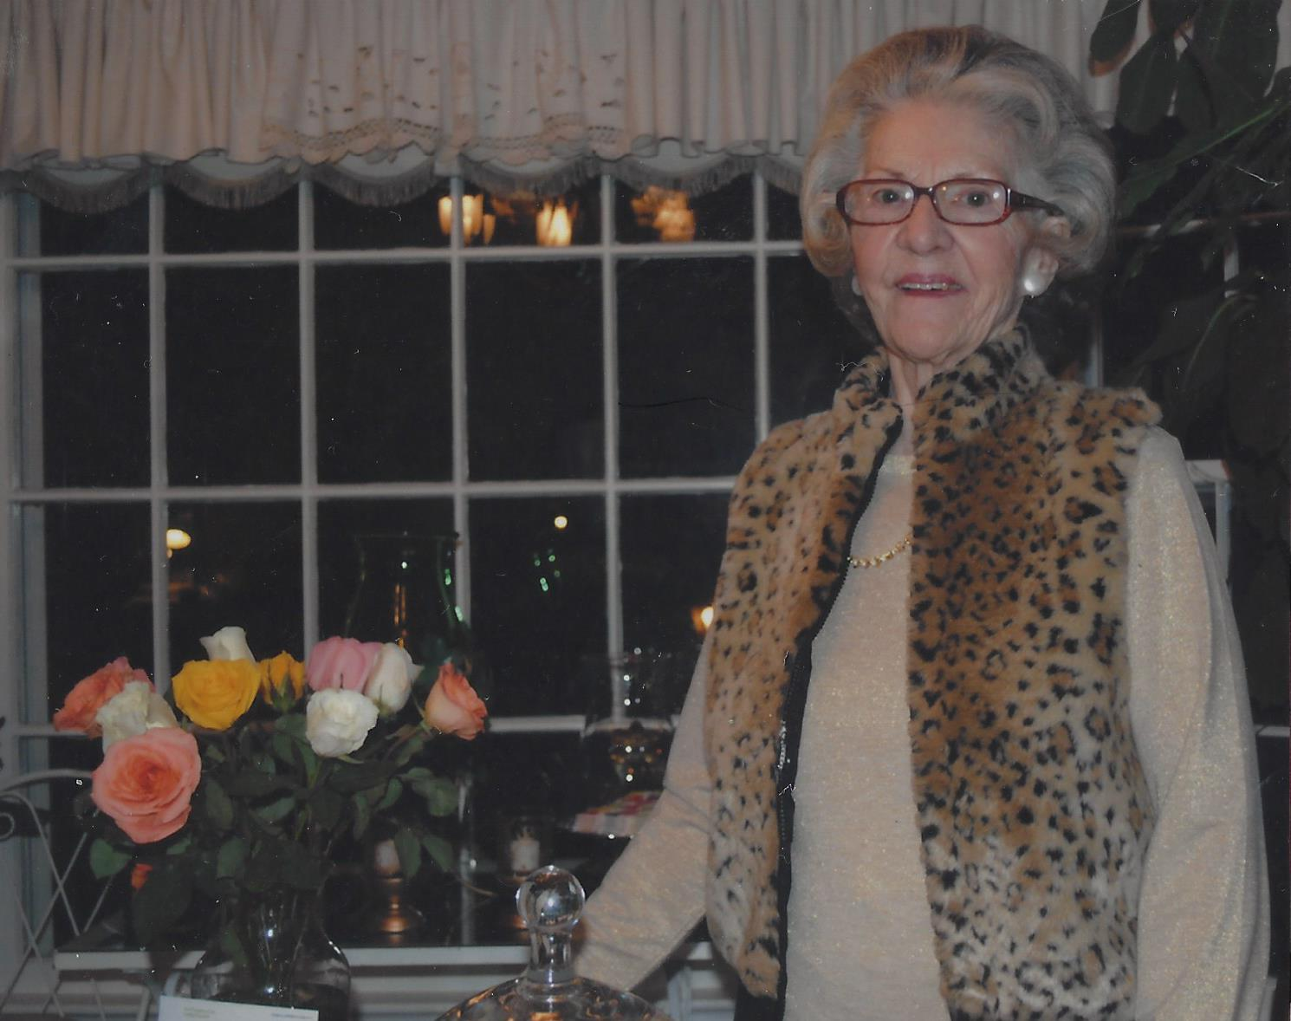
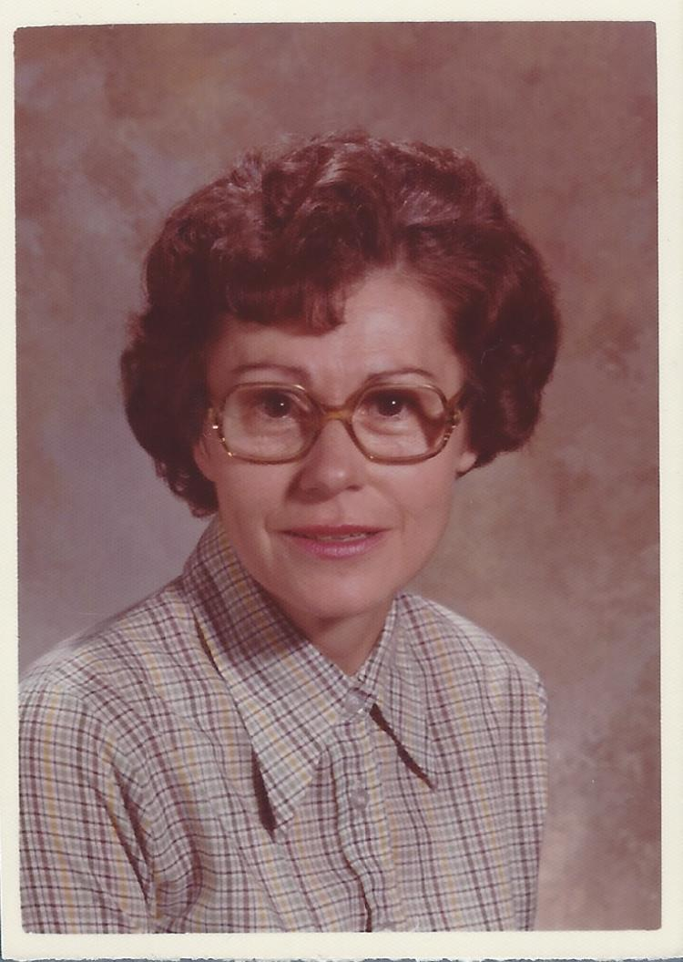
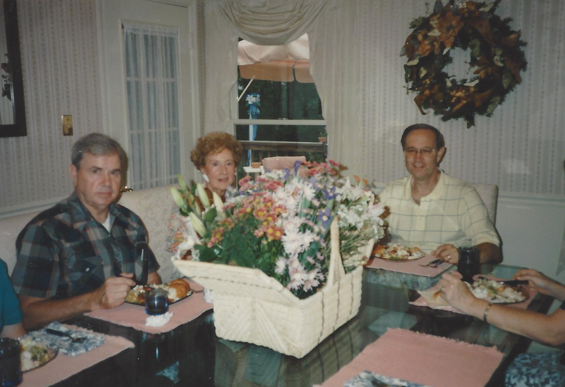
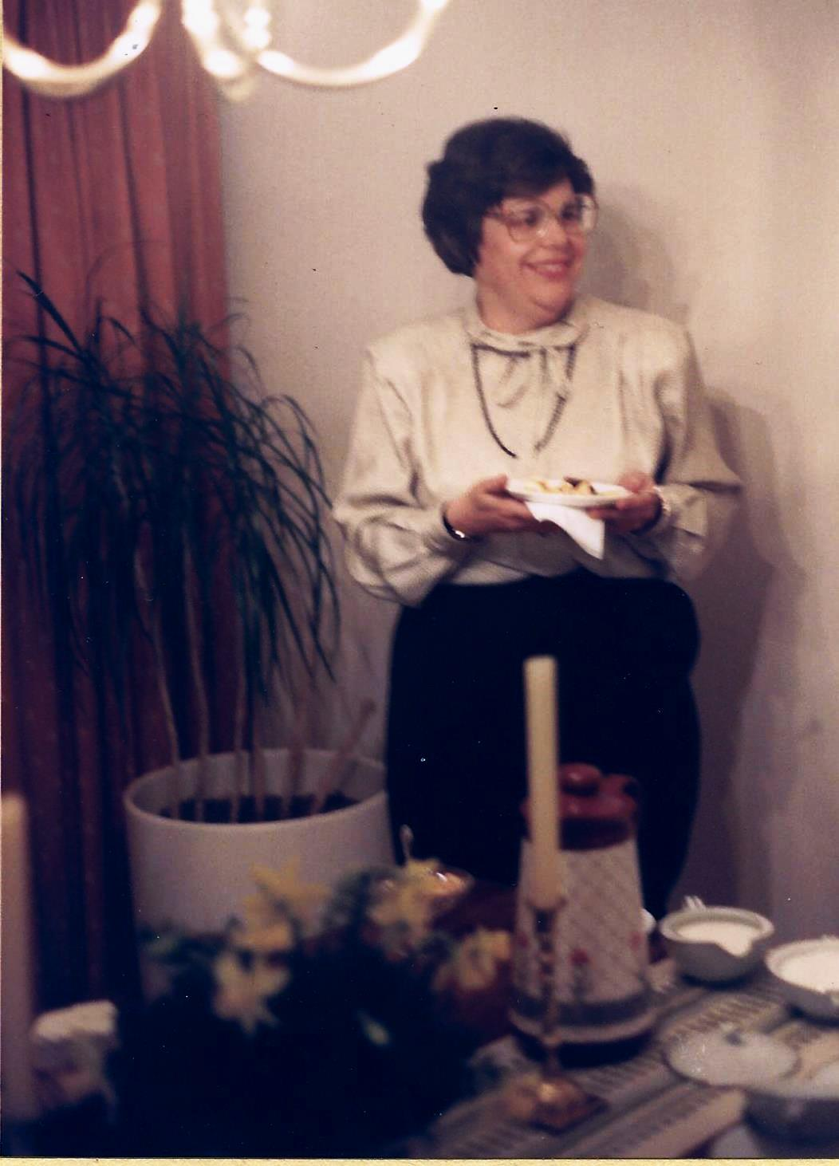
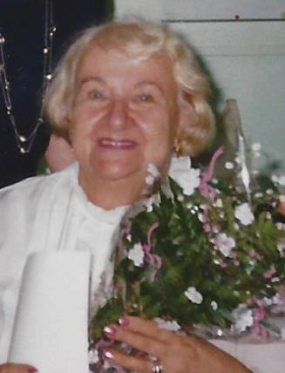
We honor lost friends
Ann Clarkson
Jimmie Nell Finley
Peg Martin
Marian Moreland
Mary Ellen Heagy
Marie White
Tommie Sellers
Peg Stovell

Slide 4

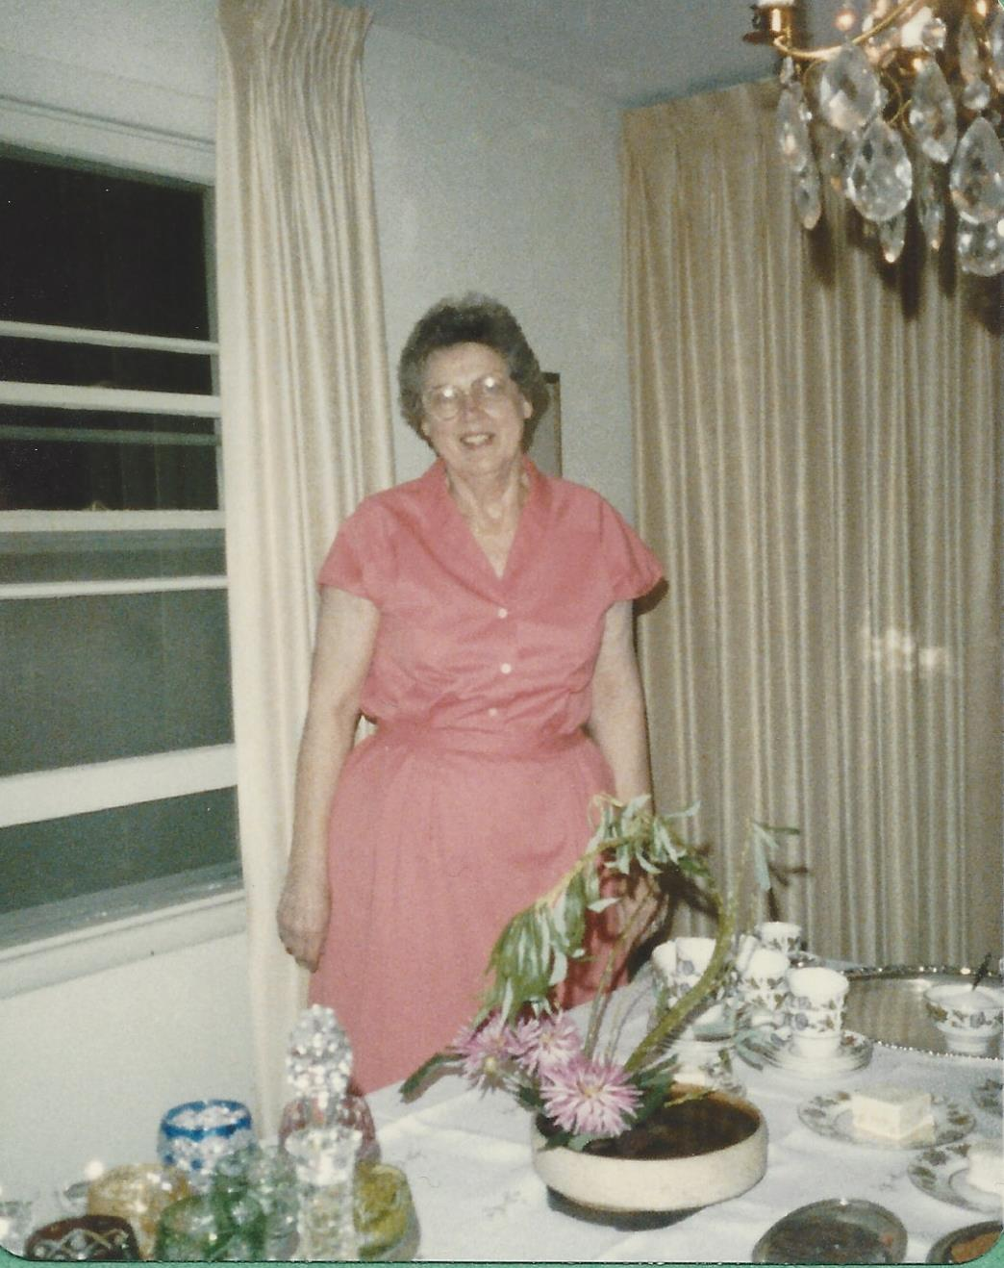
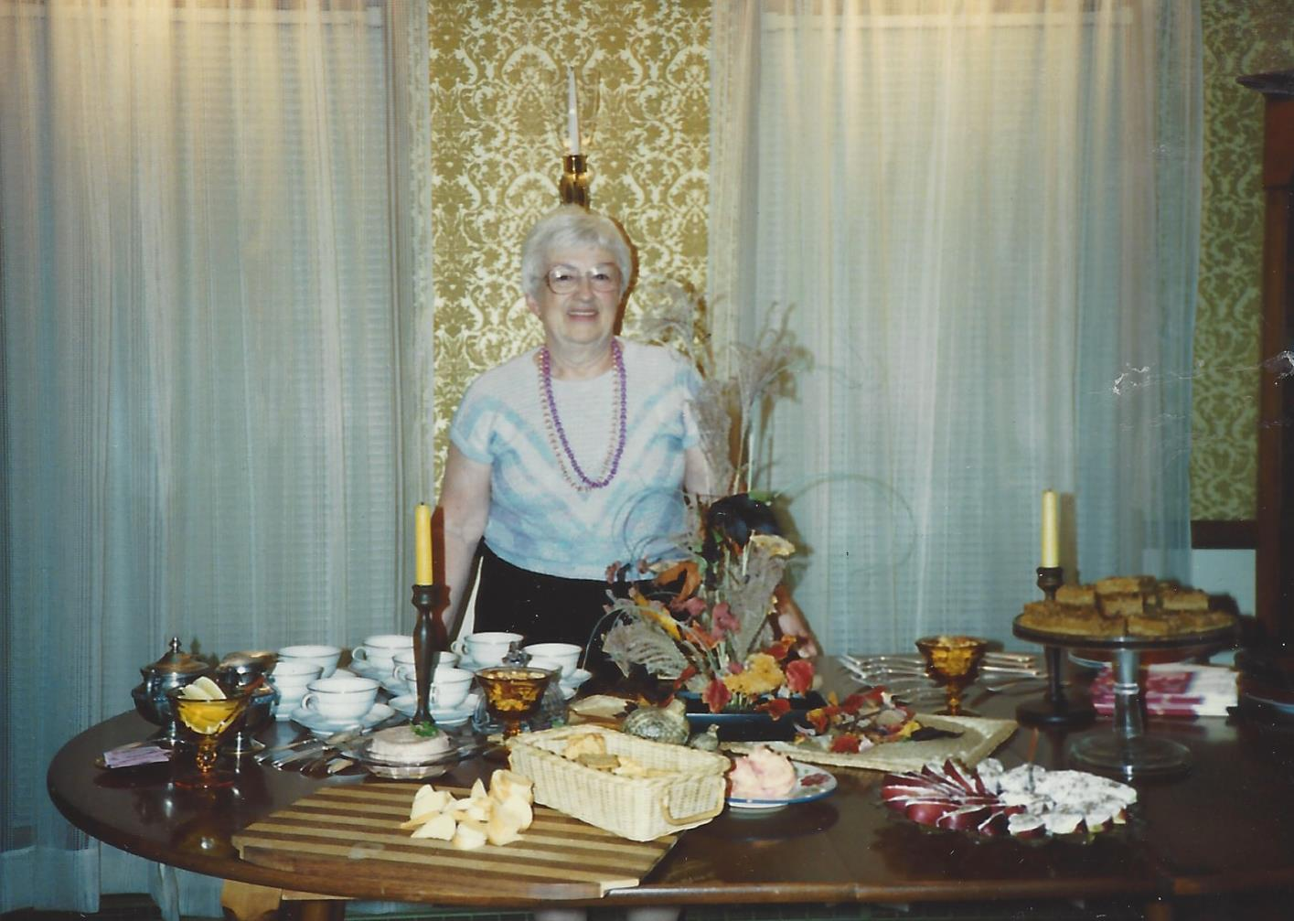
We serve our club our Presidents lead the way
Anne DeBoeser
1982-1984
Tommie Sellers
1977 - 1979
This is their name
And date

Slide 5
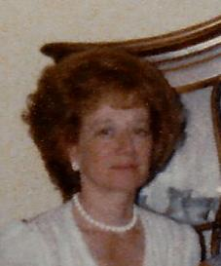
We serve our club our Presidents lead the way
Anne DeBoeser
1982-1984
Joyce Meyer
1979-1980
This is their name
And date

Slide 6
We serve our club our Presidents lead the way
Anne DeBoeser
1982-1984
Jimmie Nell Finley
1980-1981
This is their name
And date

Slide 7
We serve our club our Presidents lead the way
Anne DeBoeser
1982-1984
Ann Williams
1981-1982
This is their name
And date

Slide 8
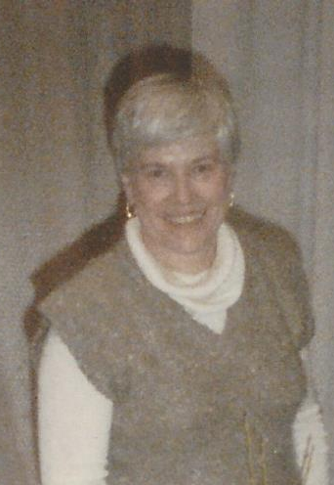
We serve our club our Presidents lead the way
Anne DeBoeser
1982-1984
Anne DeBoeser
1982-1984
This is their name
And date

Slide 9
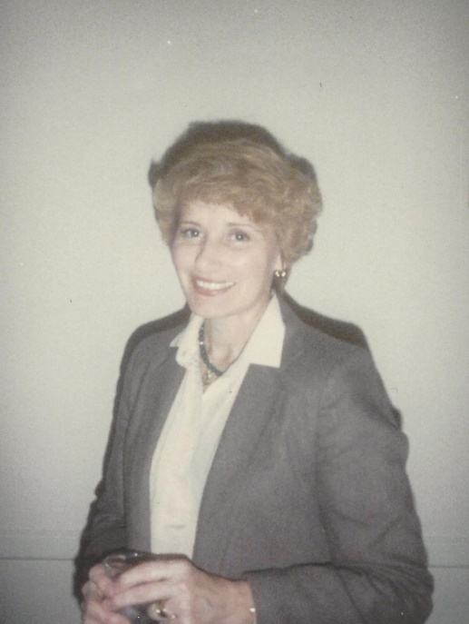
We serve our club our Presidents lead the way
Anne DeBoeser
1982-1984
Julie Harrison
1984-1986
This is their name
And date

Slide 10
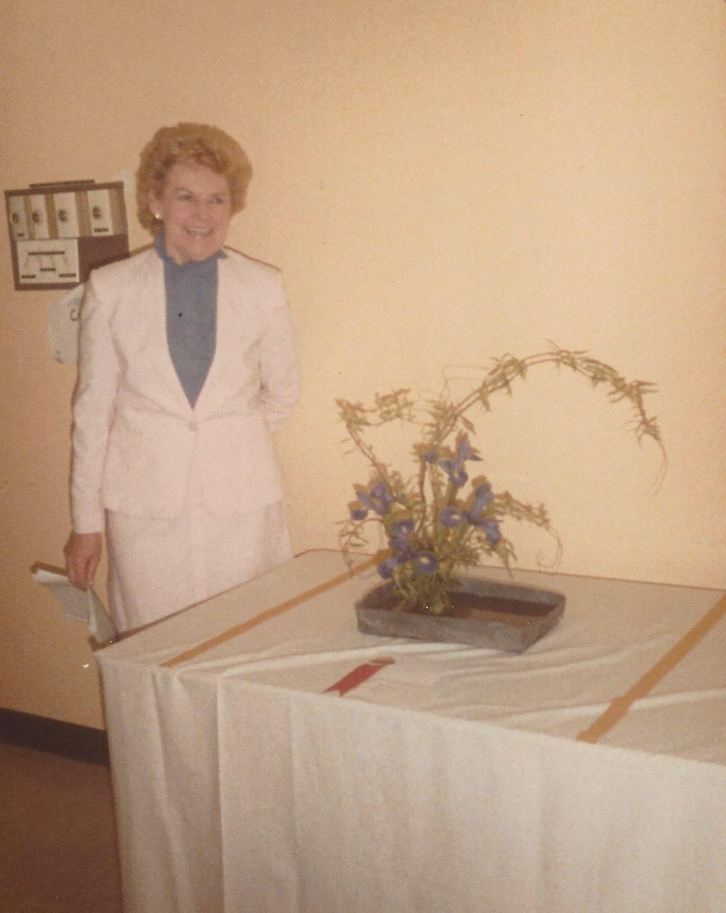
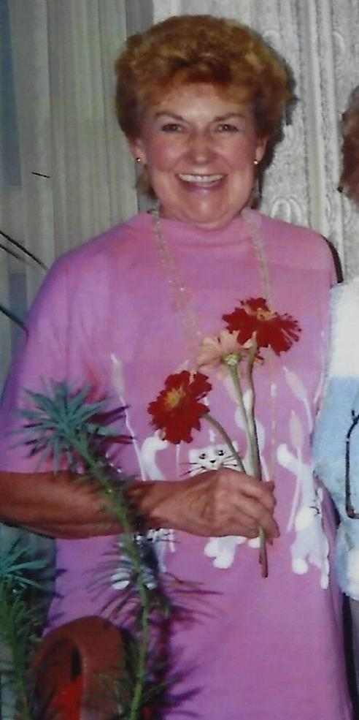
We serve our club our Presidents lead the way
Anne DeBoeser
1982-1984
Peggy Martin
1986-1988
This is their name
And date

Slide 11
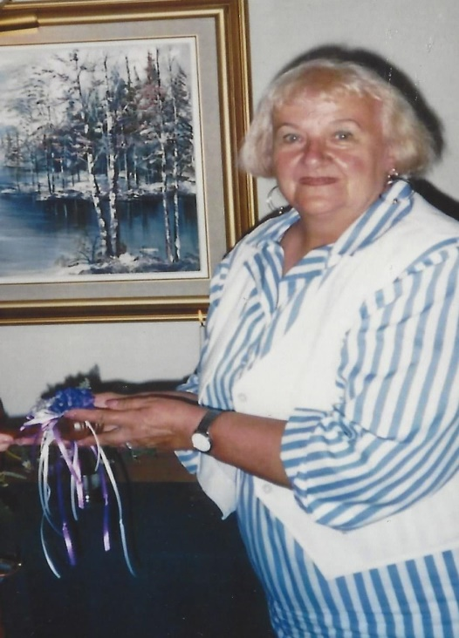
We serve our club our Presidents lead the way
Anne DeBoeser
1982-1984
Marie White
1988-1990
This is their name
And date

Slide 12
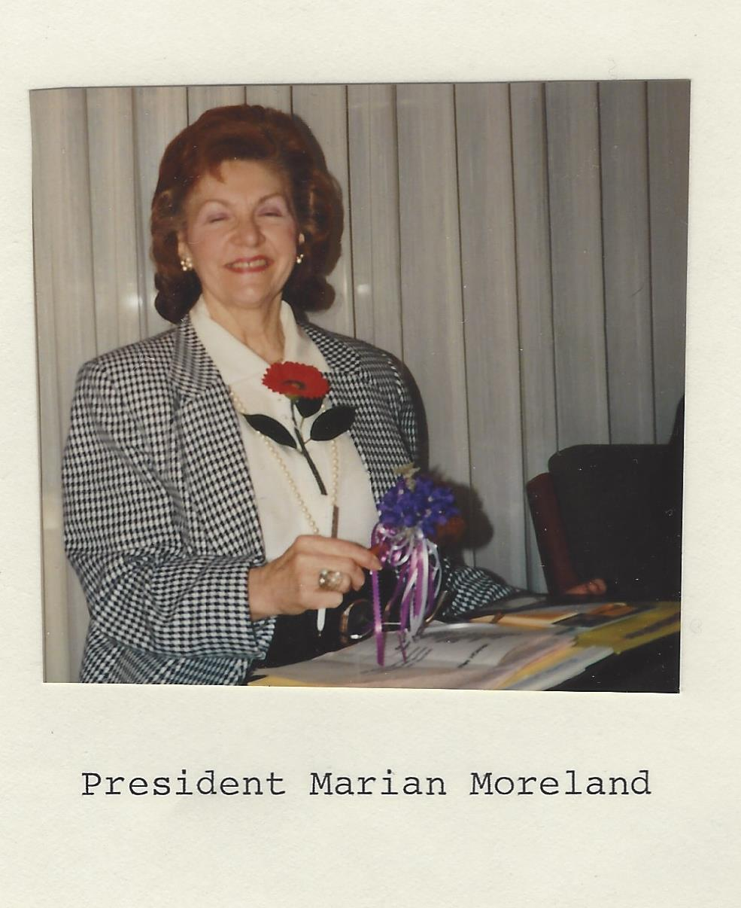
We serve our club our Presidents lead the way
Anne DeBoeser
1982-1984
Marian Moreland
1990-1992
This is their name
And date

Slide 13
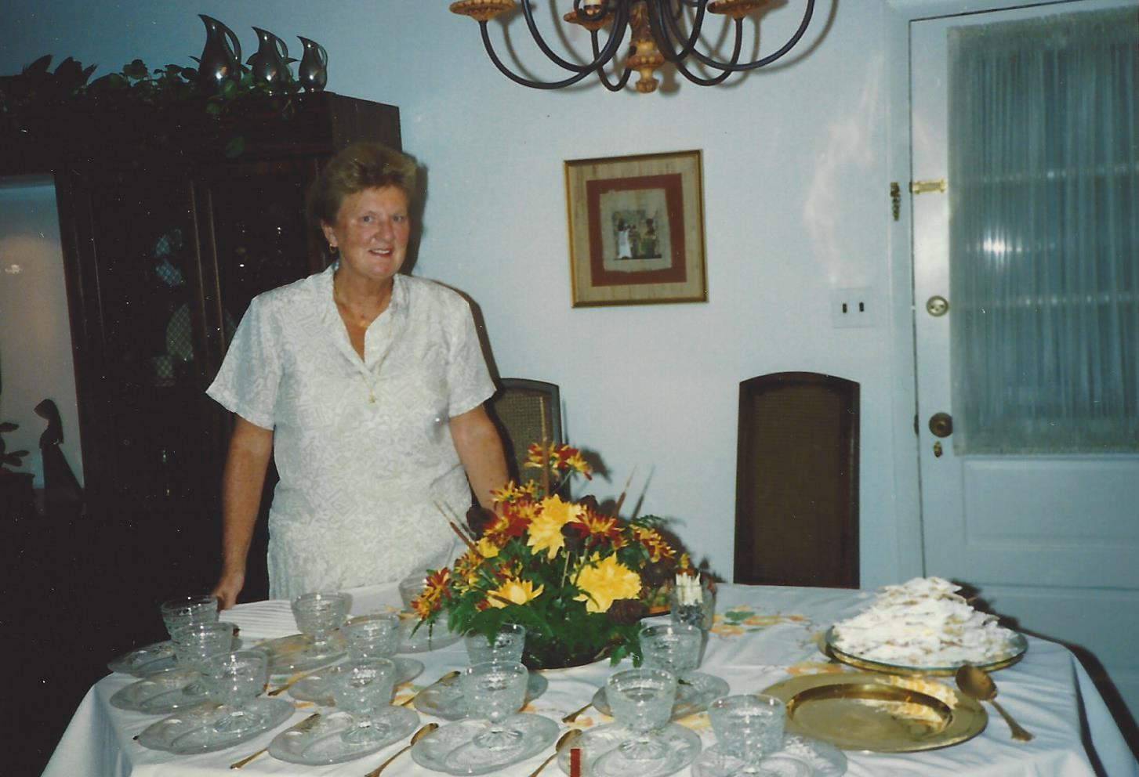
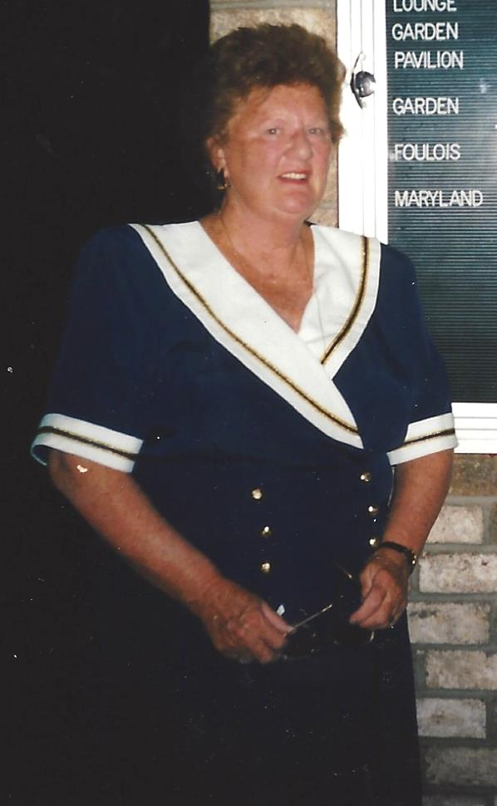
We serve our club our Presidents lead the way
Anne DeBoeser
1982-1984
Dottie Garrison
1992-1994
This is their name
And date

Slide 14
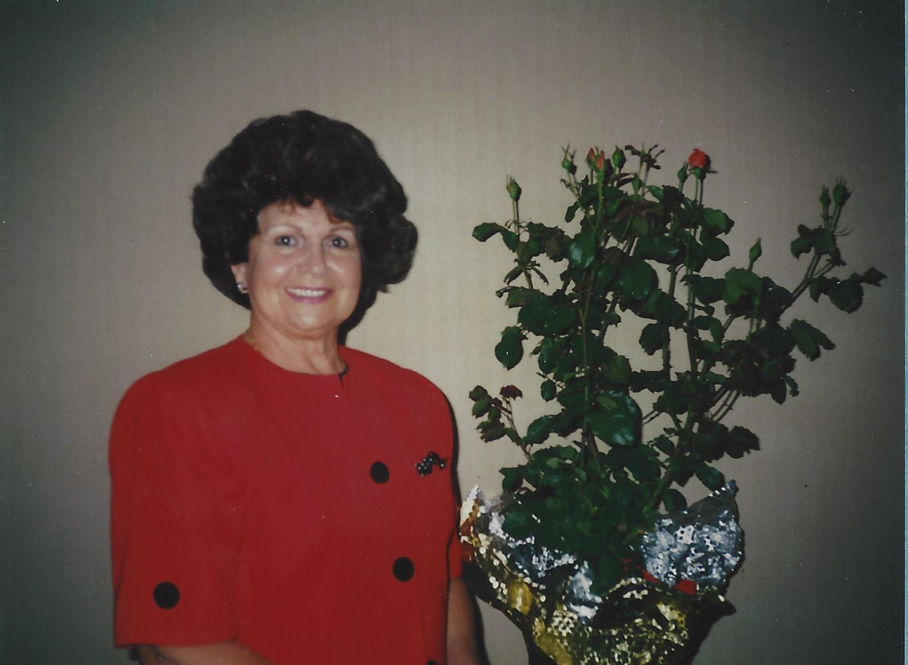
We serve our club our Presidents lead the way
Anne DeBoeser
1982-1984
Dottie Sisson
1994-1995
This is their name
And date

Slide 15
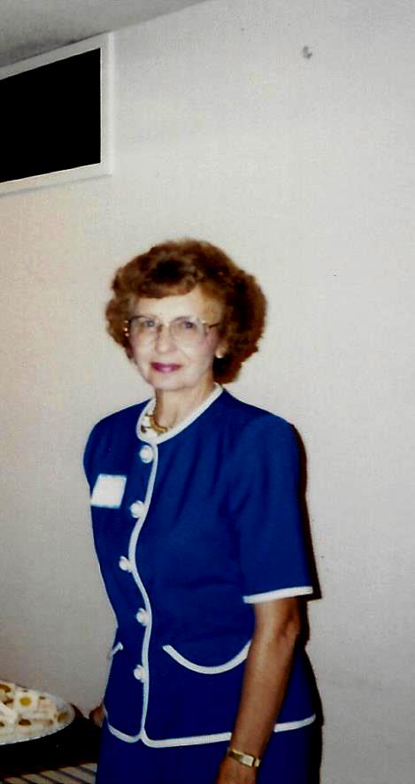
We serve our club our Presidents lead the way
Anne DeBoeser
1982-1984
Phyllis Tucker
1995-1996
This is their name
And date

Slide 16
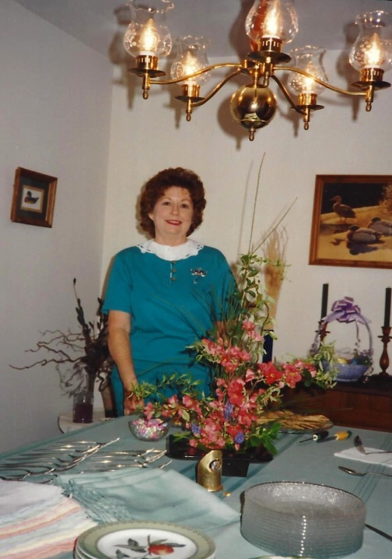
We serve our club our Presidents lead the way
Anne DeBoeser
1982-1984
Betty Abercrombie
1996-1998
This is their name
And date

Slide 17
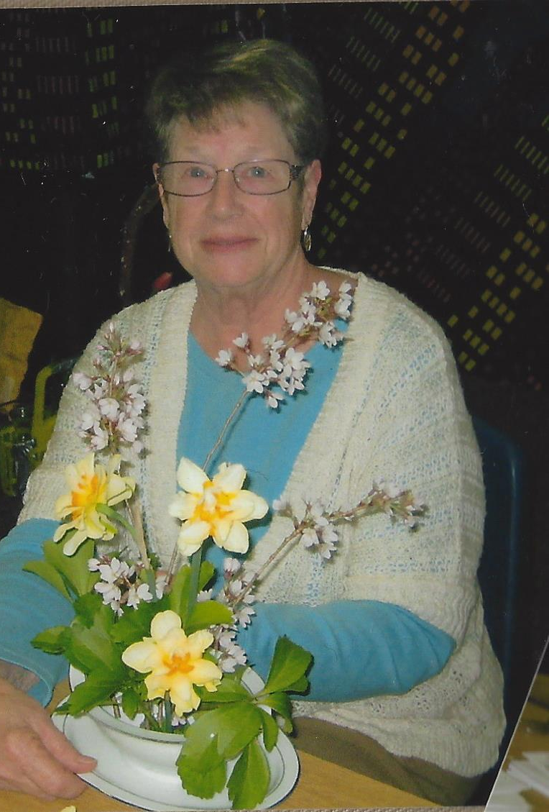
We serve our club our Presidents lead the way
Anne DeBoeser
1982-1984
Marilyn Berkut
1998-2000
This is their name
And date

Slide 18
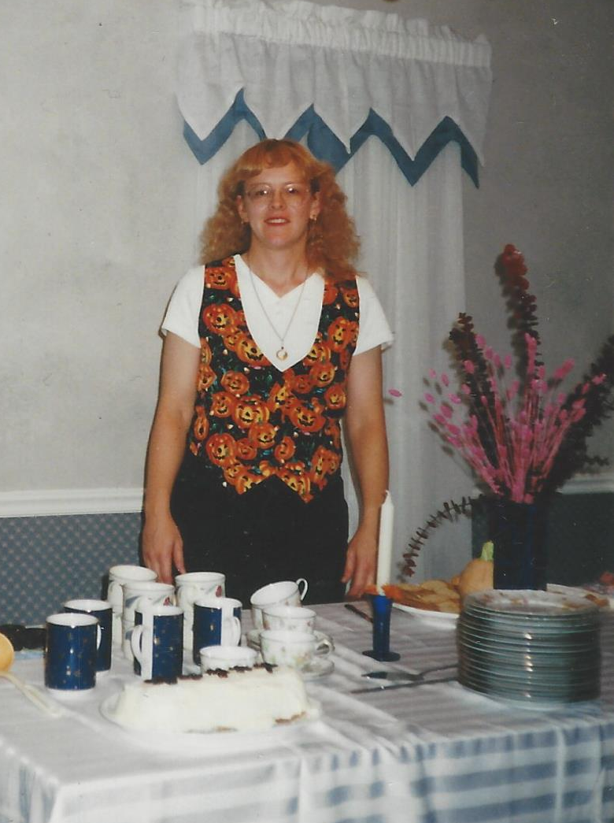
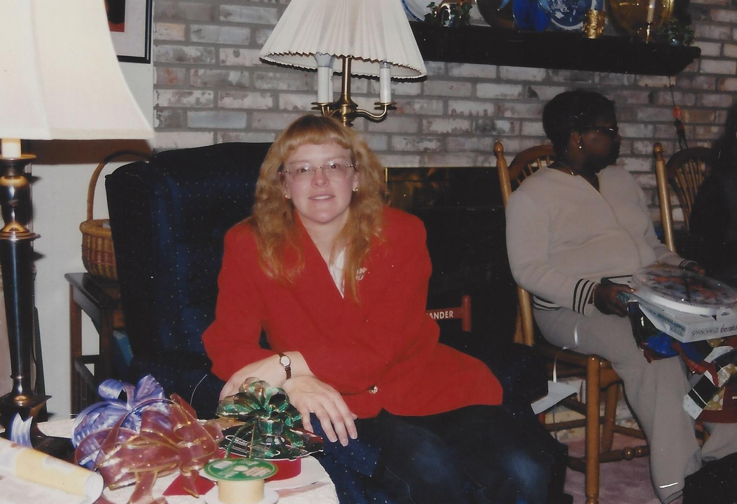
We serve our club our Presidents lead the way
Anne DeBoeser
1982-1984
Liz Saniga
2000-2001
This is their name
And date

Slide 19
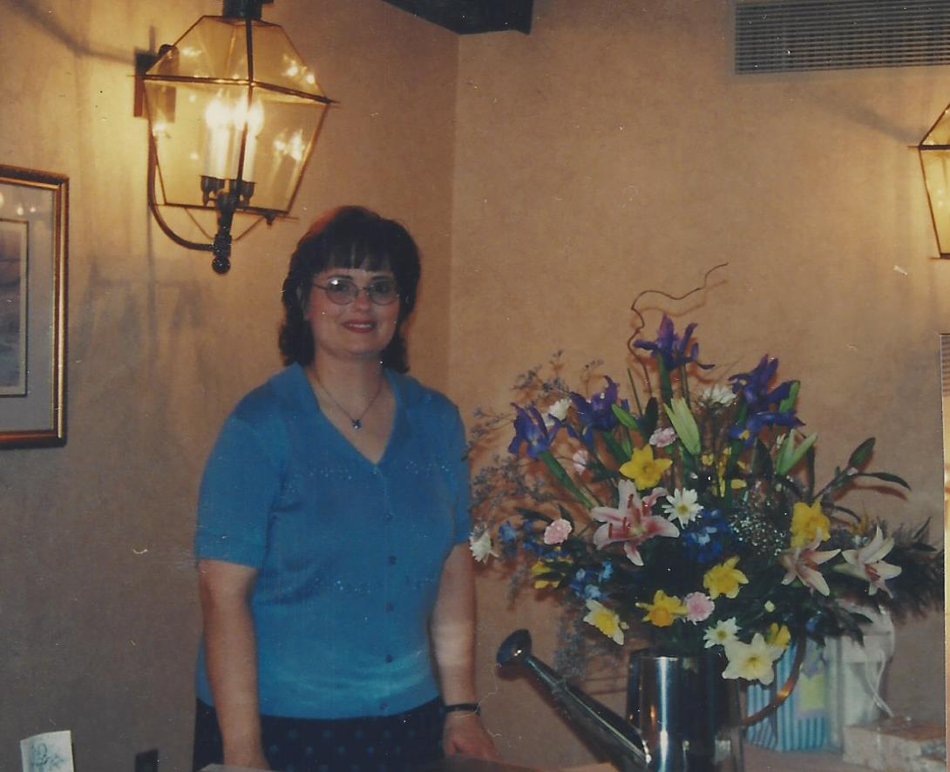
We serve our club our Presidents lead the way
Anne DeBoeser
1982-1984
Susan Hannin
2001-2002
This is their name
And date

Slide 20
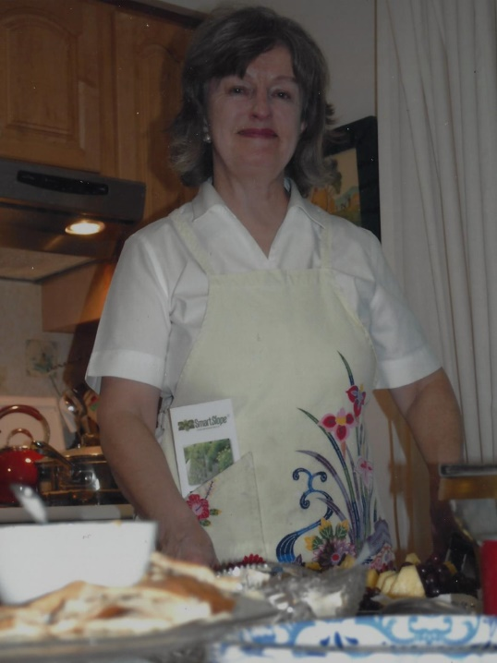
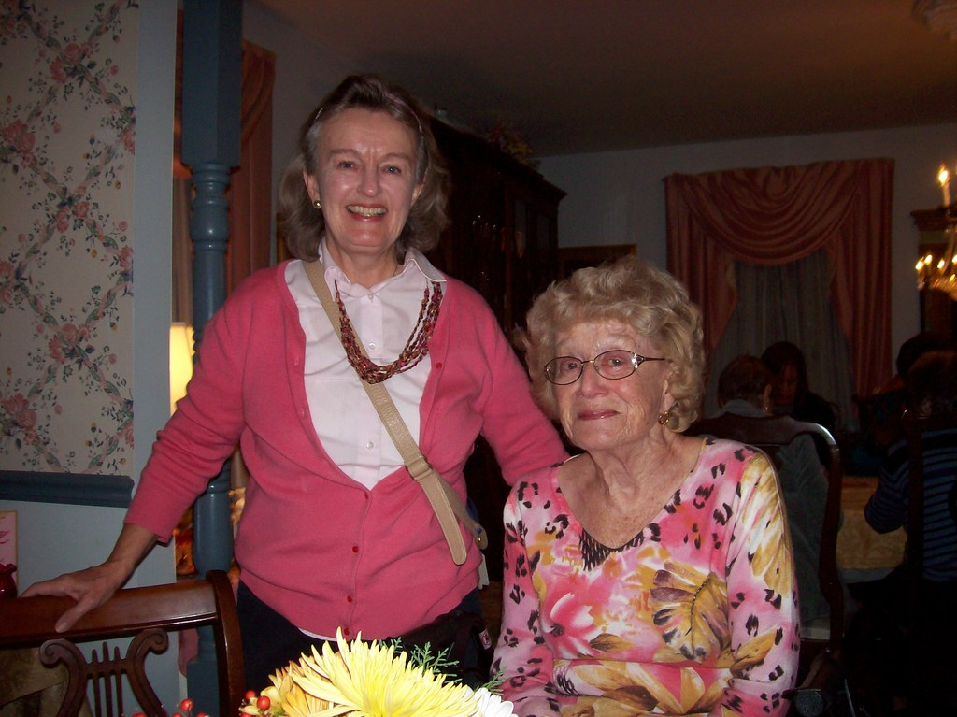
We serve our club our Presidents lead the way
Anne DeBoeser
1982-1984
Lorraine Leonard
2002-2004
This is their name
And date

Slide 21
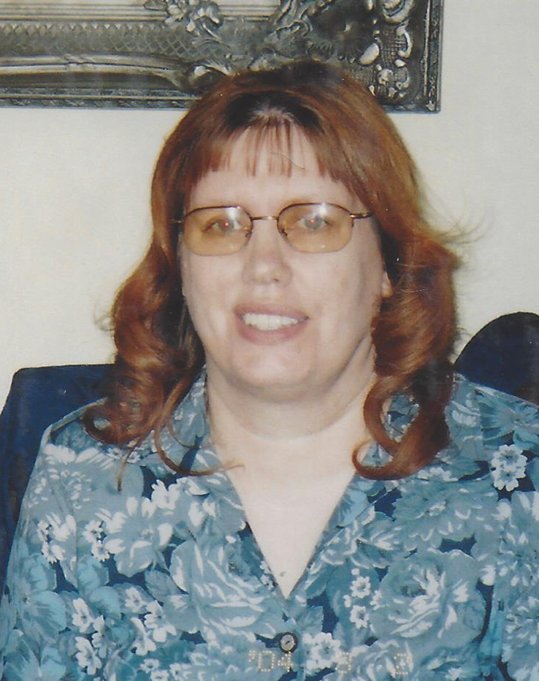
We serve our club our Presidents lead the way
Anne DeBoeser
1982-1984
Mary Jane Bishop
2004-2006
This is their name
And date

Slide 22
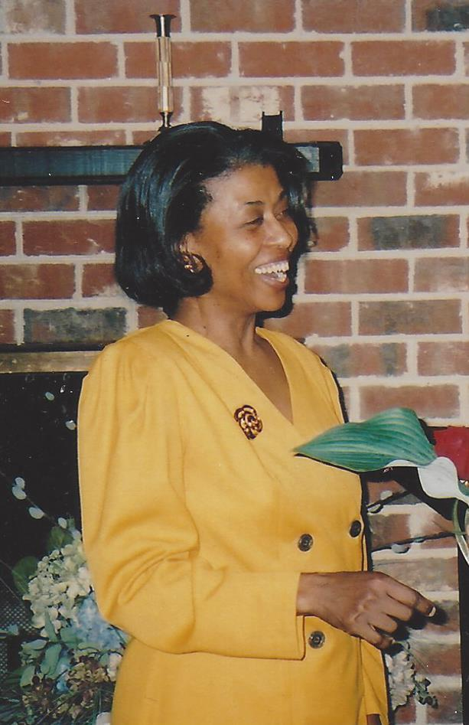
We serve our club our Presidents lead the way
Anne DeBoeser
1982-1984
Sonia Johnson
2006-2008
This is their name
And date

Slide 23
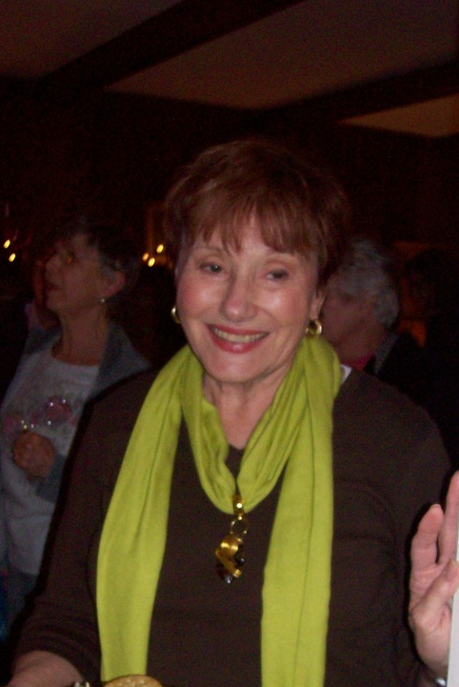
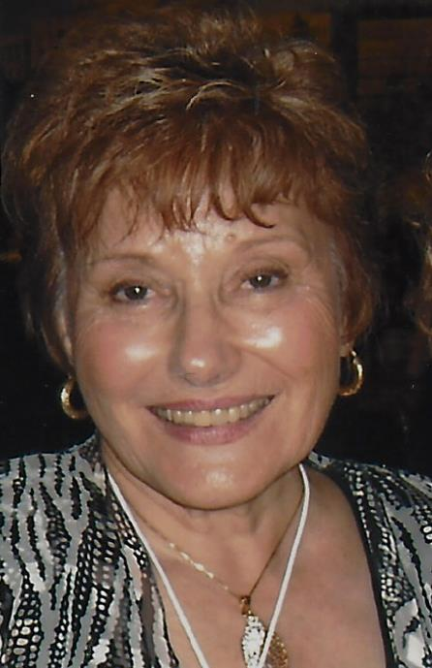
We serve our club our Presidents lead the way
Anne DeBoeser
1982-1984
Julie Harrison
2008-2012
This is their name
And date

Slide 24
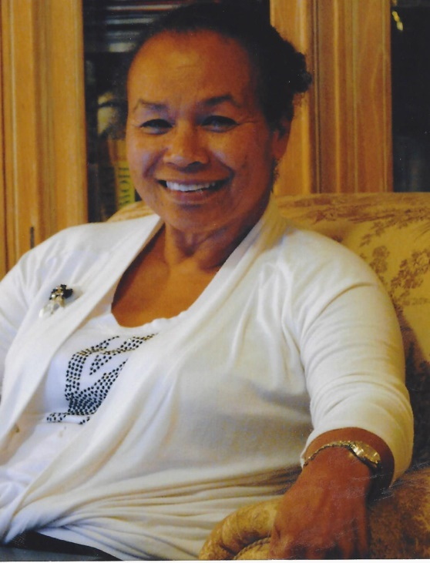
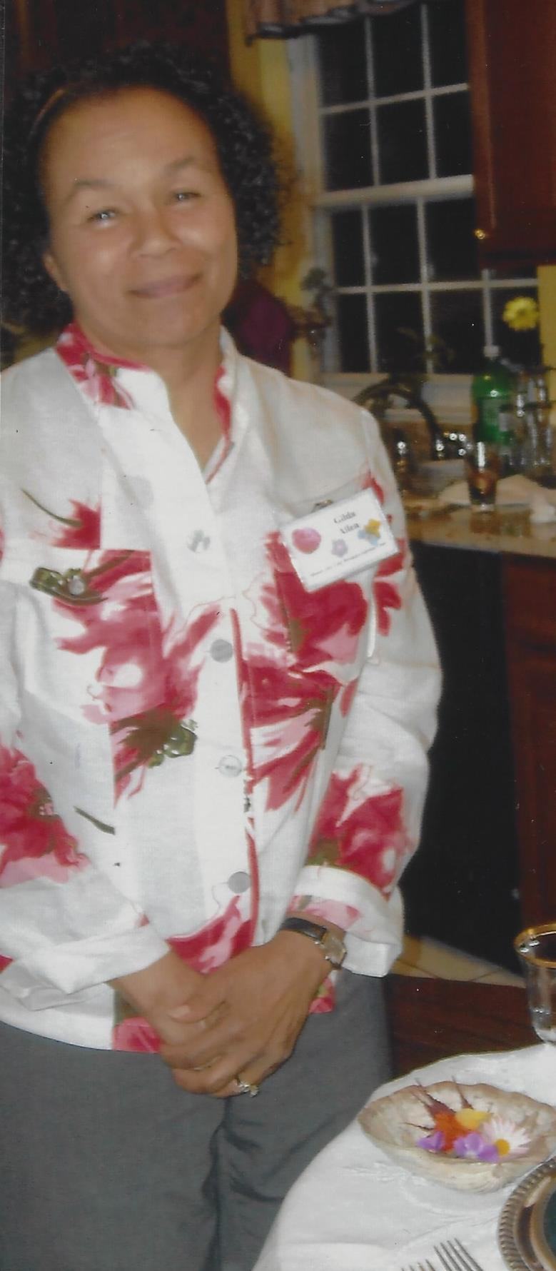
We serve our club our Presidents lead the way
Anne DeBoeser
1982-1984
Gilda Allen
2012-2015
This is their name
And date

Slide 25
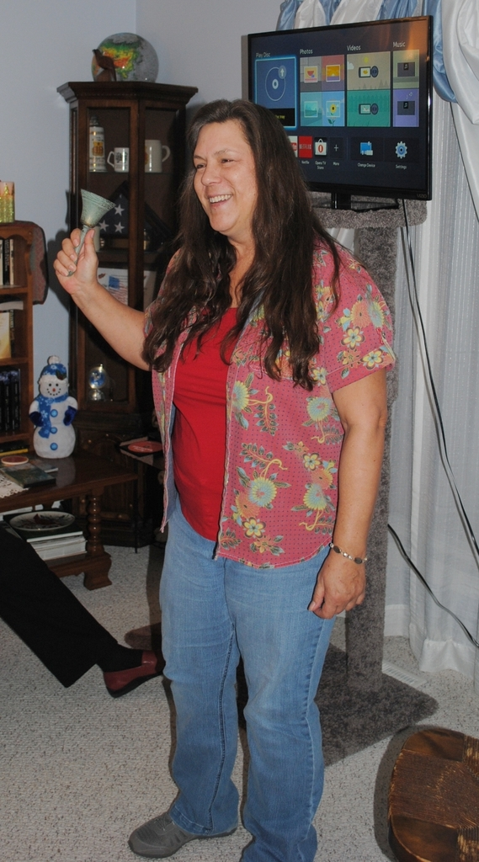
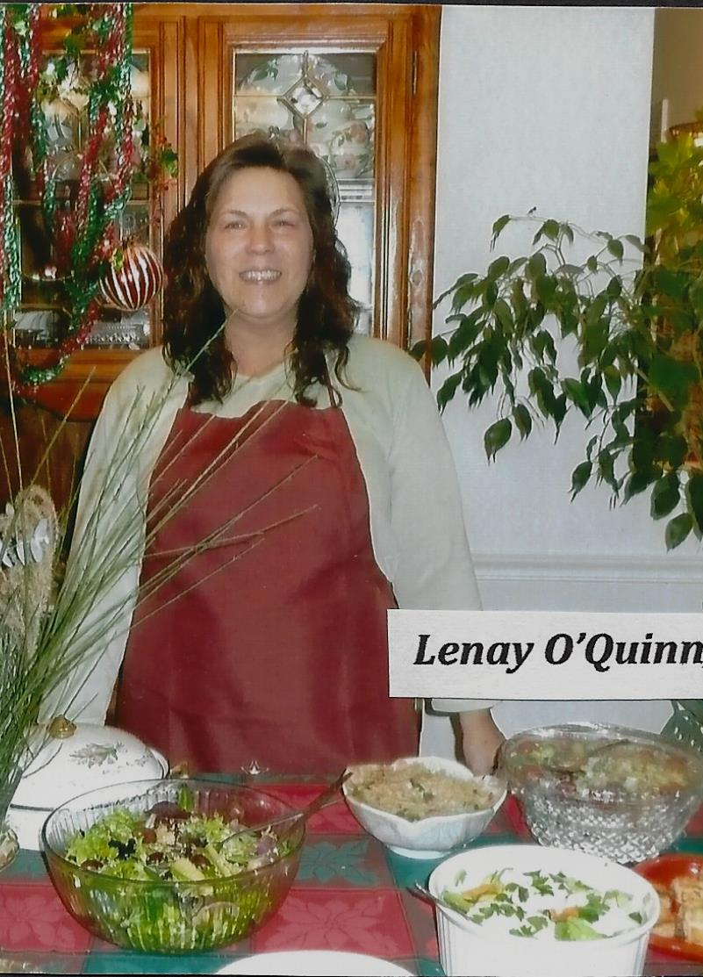
We serve our club our Presidents lead the way
Anne DeBoeser
1982-1984
Lenay O’Quinn
2015-2017
This is their name
And date

Slide 26
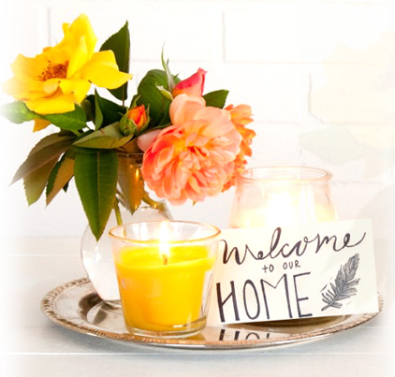
  We have meetings
Hosting Club Meetings

Slide 27
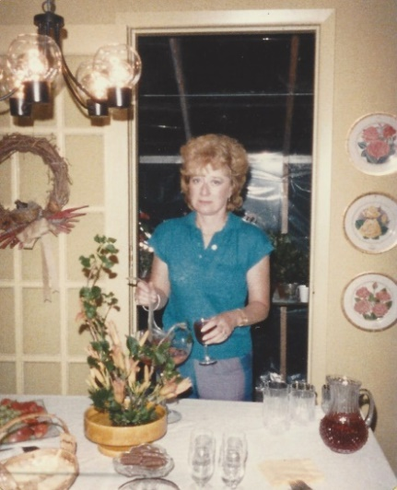
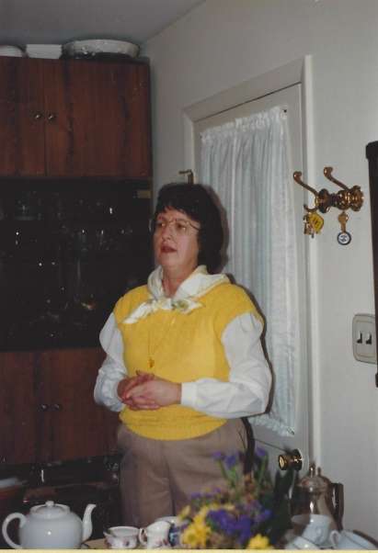
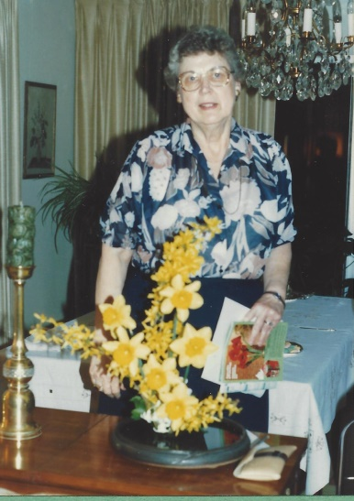
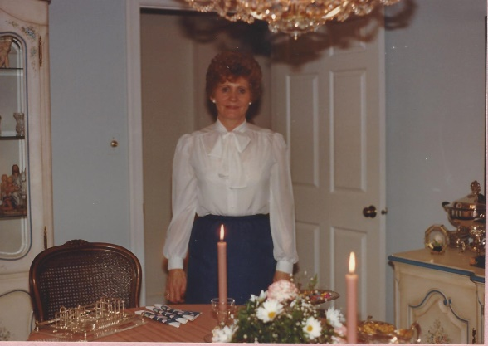
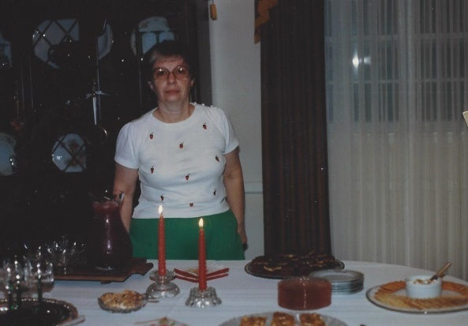
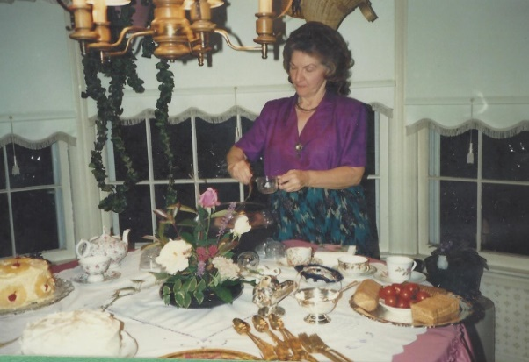

  We serve as hostess’
Joyce Meyer 1984-1985
Esther Neckere 1986-1987
Joann Davis
1986-1987
Jimmie Nell Finley
1986-1987
Margaret Hicks
1987-1988
Marian Moreland
1988-1989
Dottie Garrison
1989-1990

Slide 28
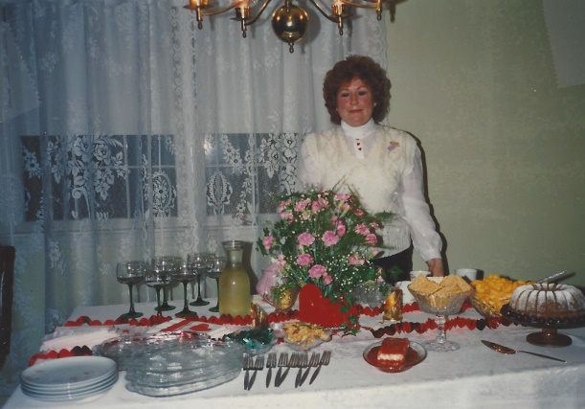
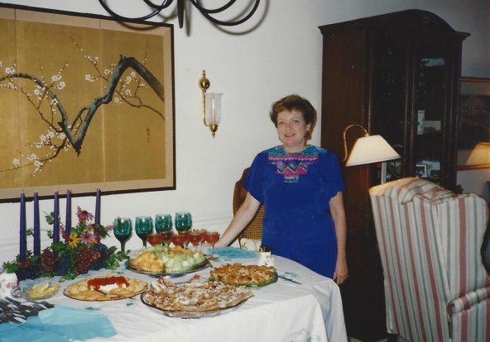
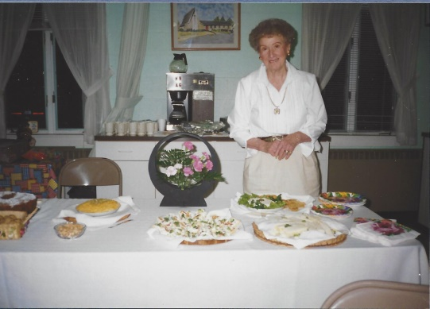
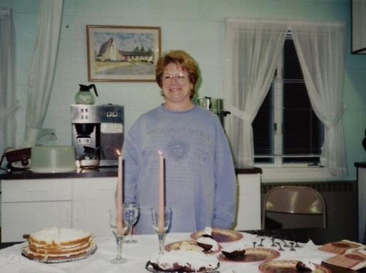
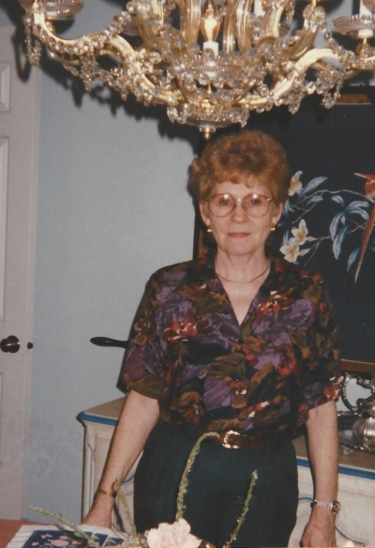


  We serve as hostess’
Betty Abercrombie
1990-1991
Elaine Arnold
1993-1994
Peg Stovall
1993-1994
Joann Davis
1996-1997
May Kemp
1995-1996
Ann Williams
1997-1998
Marilyn Berkut
1994-1995

Slide 29







  We serve as hostess’
Gilda Allen
2003-2004
Julie Harrison
2003-2004
Mary Beth Cecil & Ann Williams
2004-2005
Sonia Johnson
2005-2006
Lorraine Leonard
2006-2007
Also in picture: Marsha Kirchoff’s daughter Sarah and Lorraine’s son Thomas
Pam Smart
2007-2008
Diana Morse
2008-2009

Slide 30







  We serve as hostess’
Dot Lower
2010-2011
Lenay O’Quinn
2010-2011
Iona Black
2008-2009
Arminta Donovan
2009-2010
Marsha Kirchoff
2010-2011
Pat Hall
2010-2011
Elaine Arnold
2016-2017

Slide 31





  and enjoy good food
Arminta Donovan Official Cake Cutter

Slide 32



  some meetings are away from home
1983-1984 Col Thompson at the Budweiser Distribution hall
1991-1992 Penwick House

Slide 33




  Some meetings we welcome new members
Lenay O’Quinn
2007-2008
Iona Black
2007-2008
Marsha Kirchoff
2008-2009
Jessica Sherlock
2011-2012

Slide 34



  Some meetings we exchange plants
Our First Plant Exchange
1984-1985
2004-2005 at Dorothy Weberlings
2006-2007 at Jackie George’s

Slide 35


  We create in many ways

Slide 36





  We create in many ways
  (tables)
Marian Moreland
1989-1990
Joyce Meyer
2006-2007
Carol Ober
2005-2006
Arminta Donovan
2016-2017
Deborah Determan
2015-2016

Slide 37











  We create in many ways
  (media)
Past and Current editions of Breaking News
History Books
Yearbooks

Slide 38





  We create in many ways
  (Flower Arrangements)

Slide 39





  We create in many ways
  (Flower Arrangements)

