Slide 1
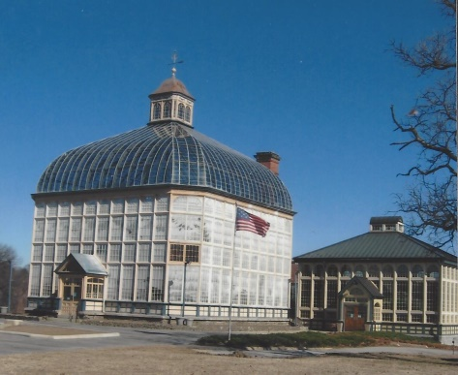
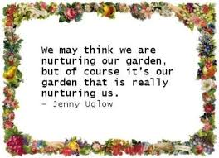
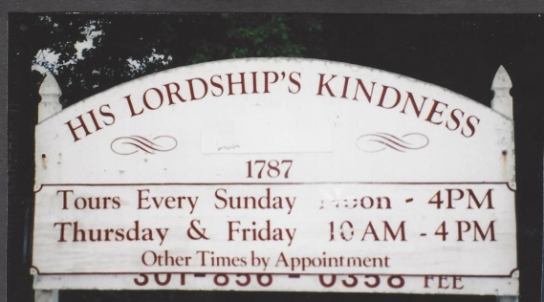
We tour our gardens

Slide 2
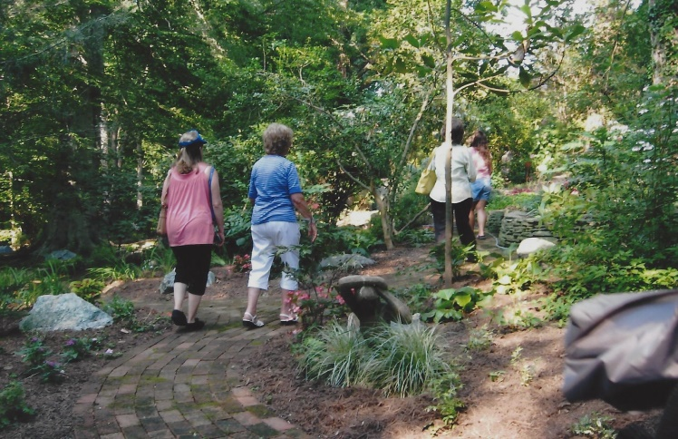
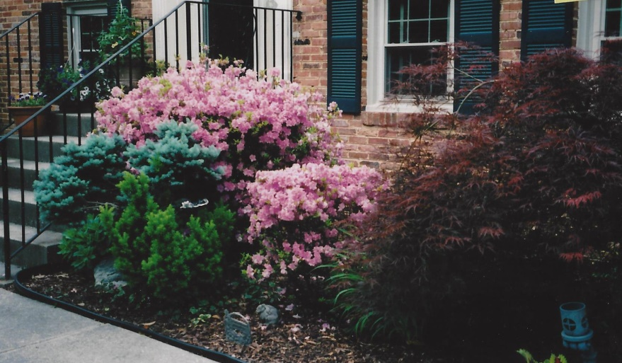
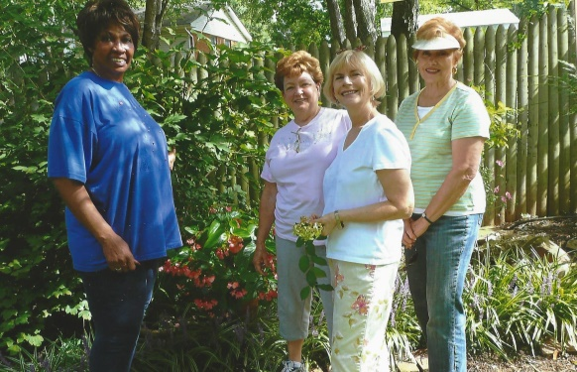
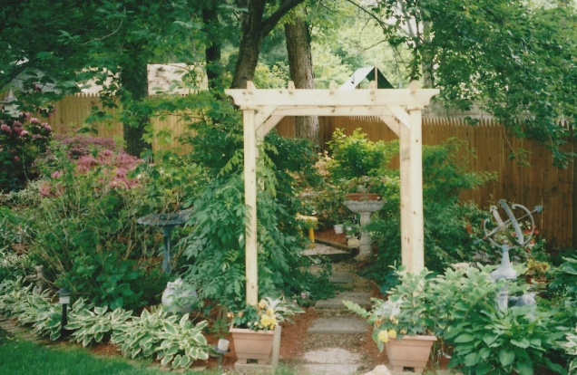
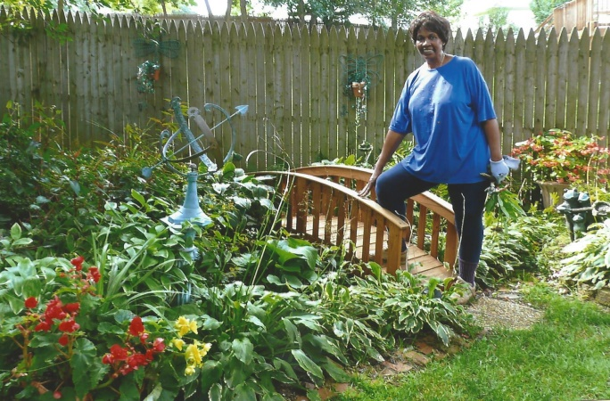
We tour our gardens
2009-2010
Joyce Meyer
2008-2009
Elaine Arnold
2008-2009
Iona Black

Slide 3
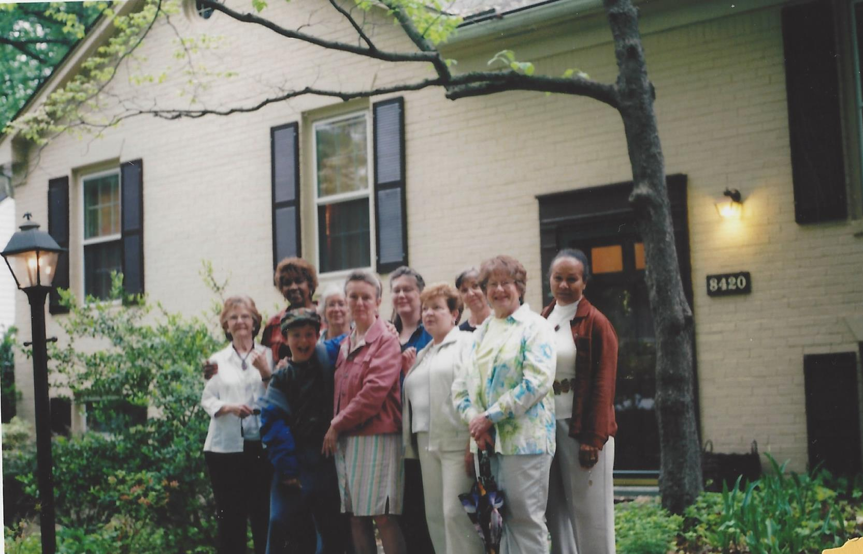
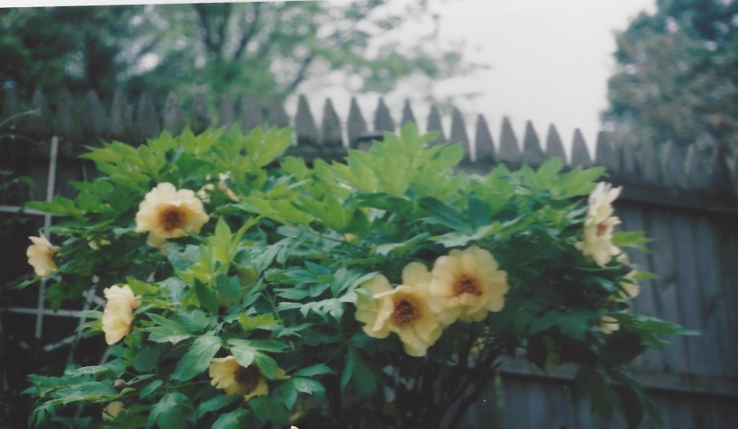
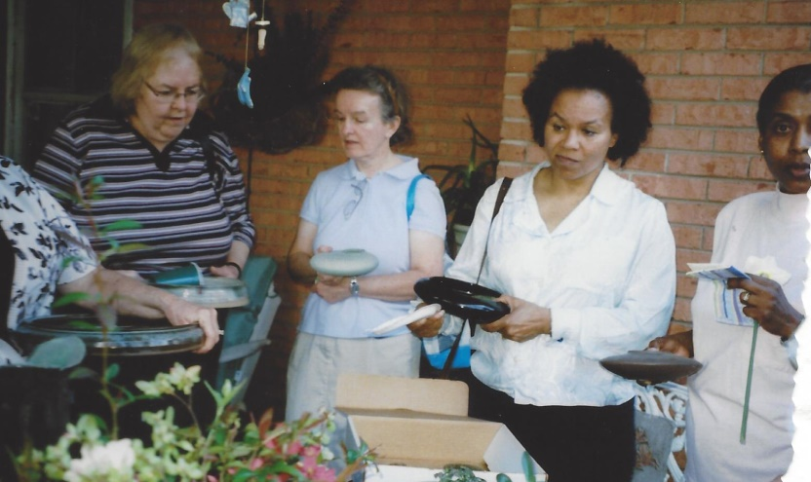
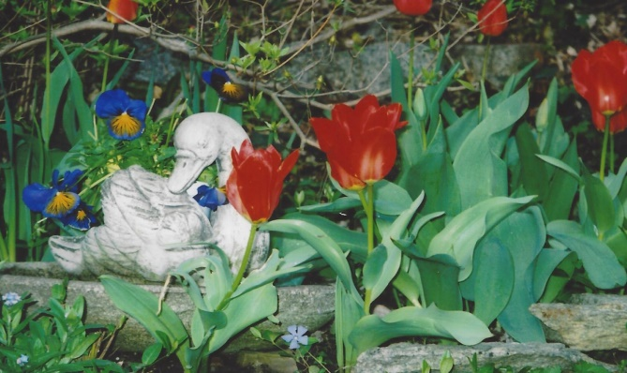
We tour our gardens
2007-2008
Lorraine Leonard
2007-2008
Marian Moreland

Slide 4
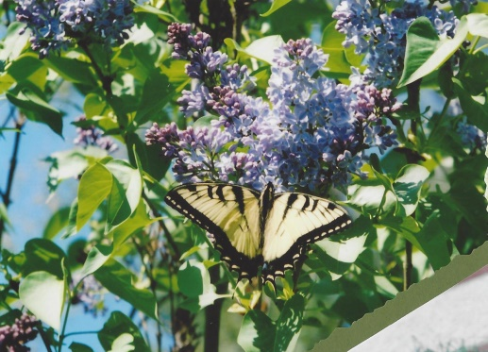
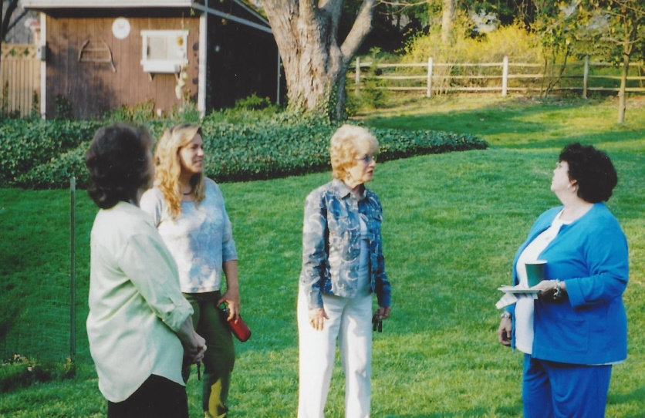
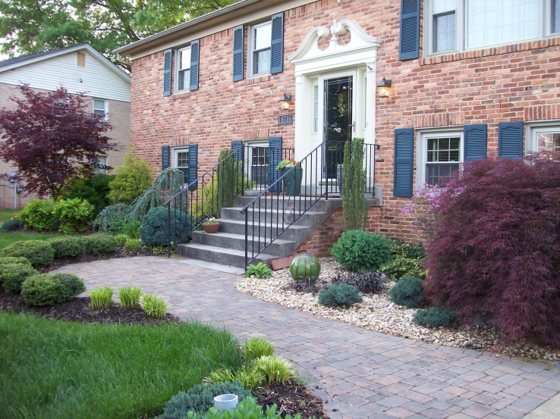
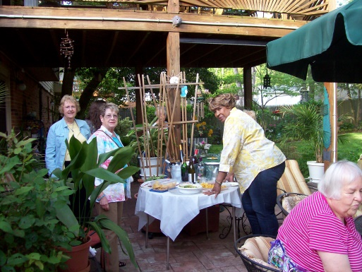
We tour our gardens
2007-2008
Pam Smart
2014-2015
Iona Black
2014-2015
Elaine Arnold

Slide 5
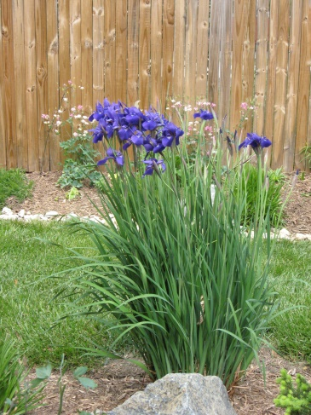
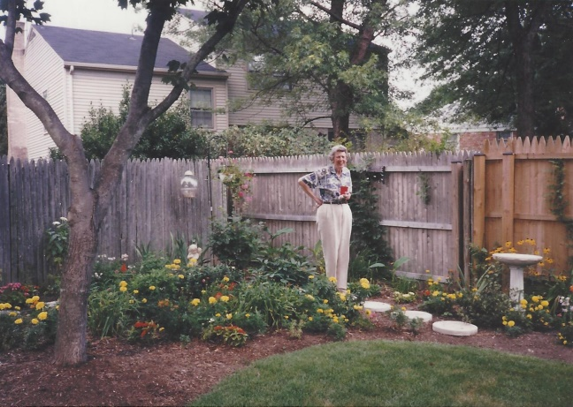
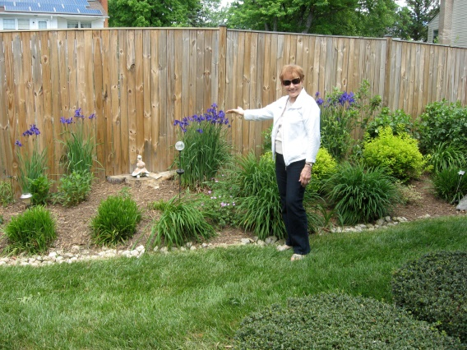
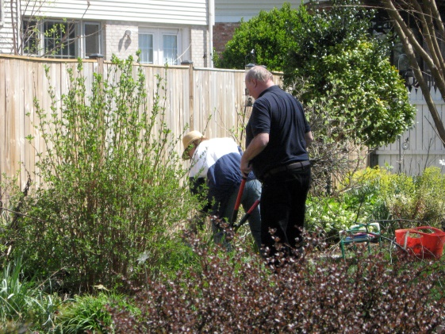
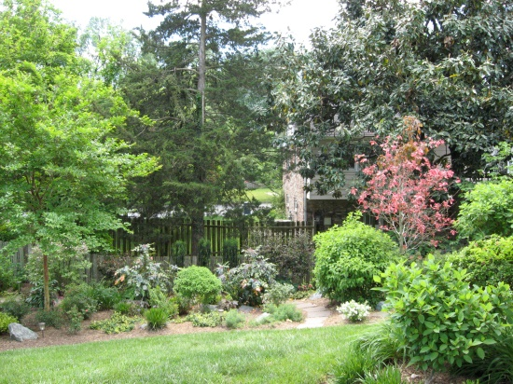
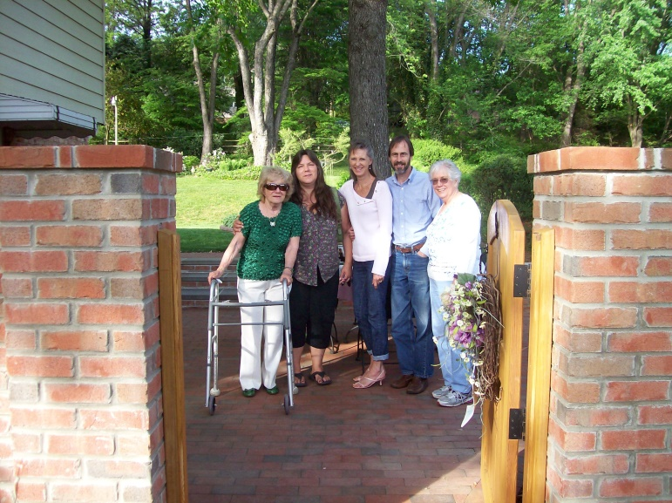
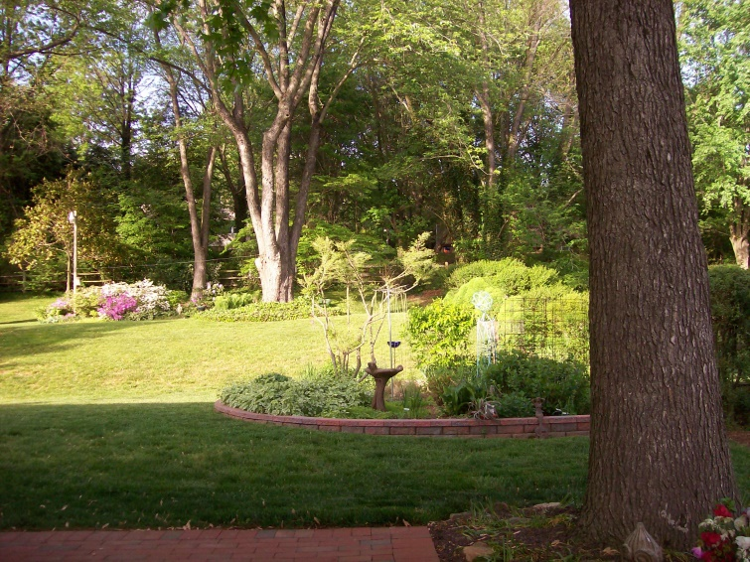
We tour our gardens
1999-2000
Jimmie Nell Finley in
Julie Harrison’s garden
2016-2017
Julie Harrison
2014-2015
Pam Smart

Slide 6
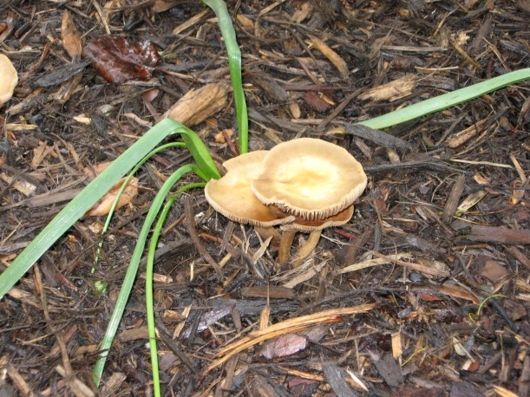
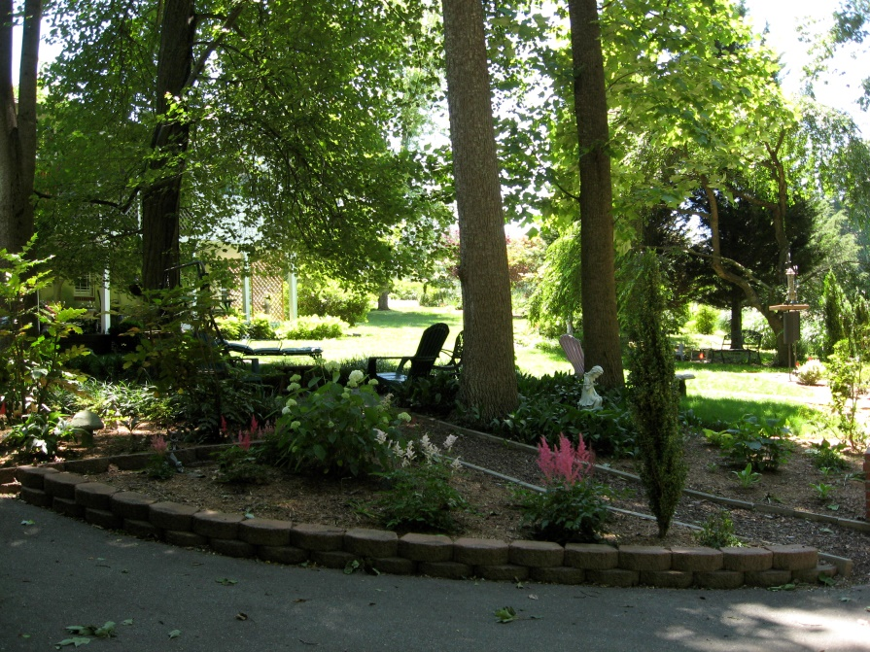
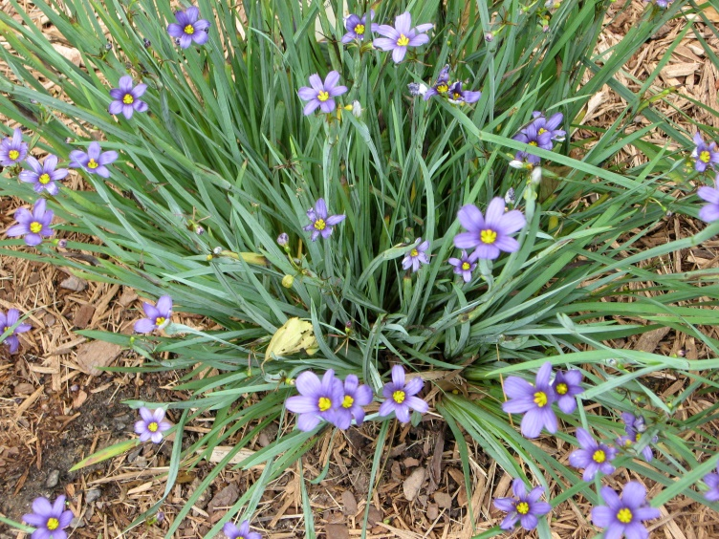
We tour our gardens
2015-2017
Linda Millette

Slide 7
We tour our gardens
2015-2017
Linda Millette

Slide 8
We tour our gardens
2015-2017
Linda Millette

Slide 9
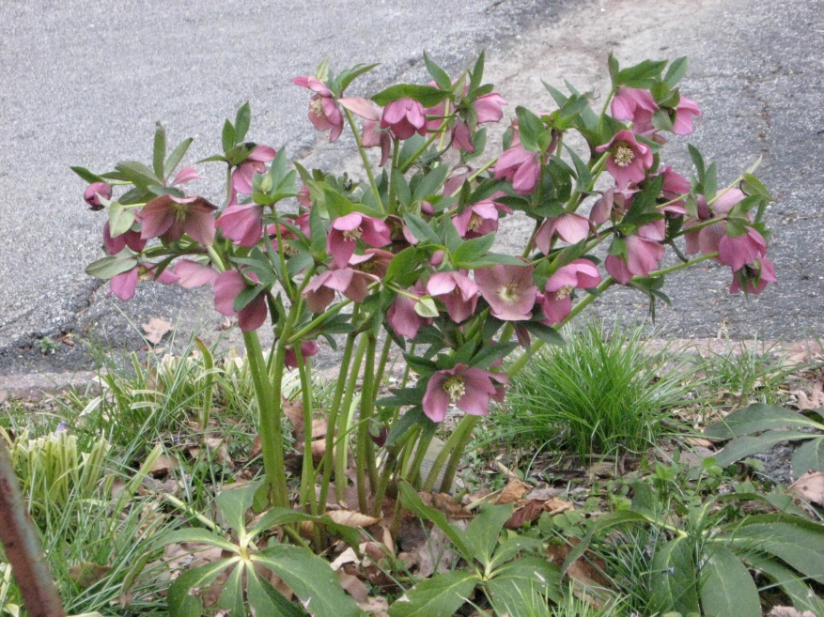
We tour our gardens
2015-2017
Linda Millette

Slide 10
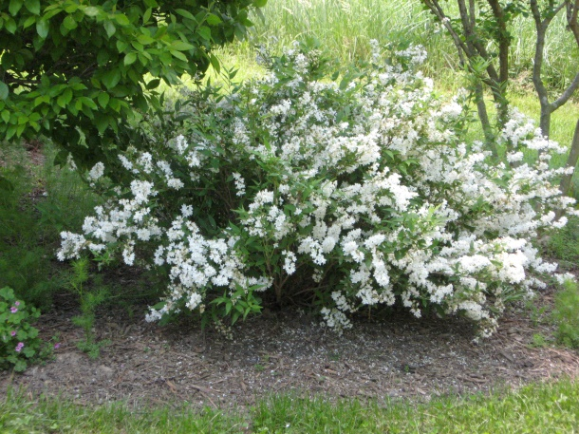
We tour our gardens

Slide 11
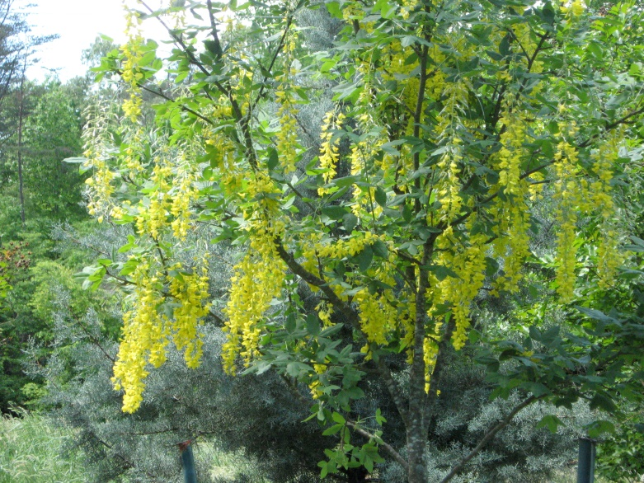
We tour our gardens
2015-2017
Linda Millette

Slide 12
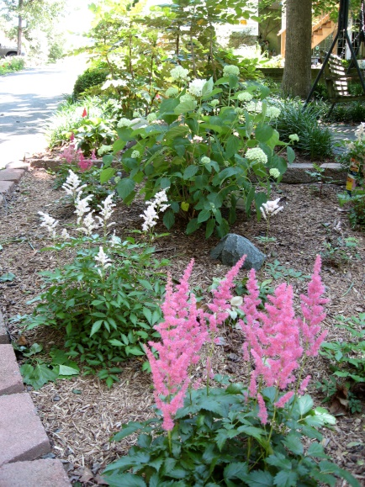
We tour our gardens
2015-2017
Linda Millette

Slide 13

We volunteer

Slide 14
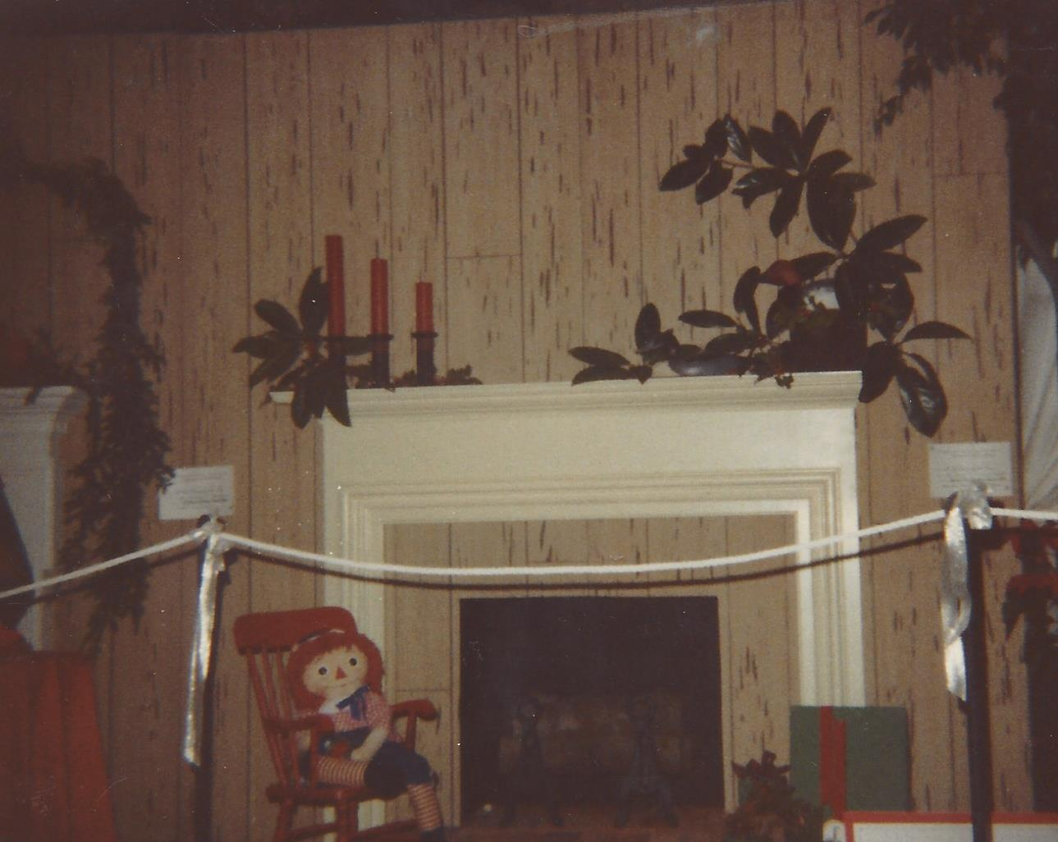
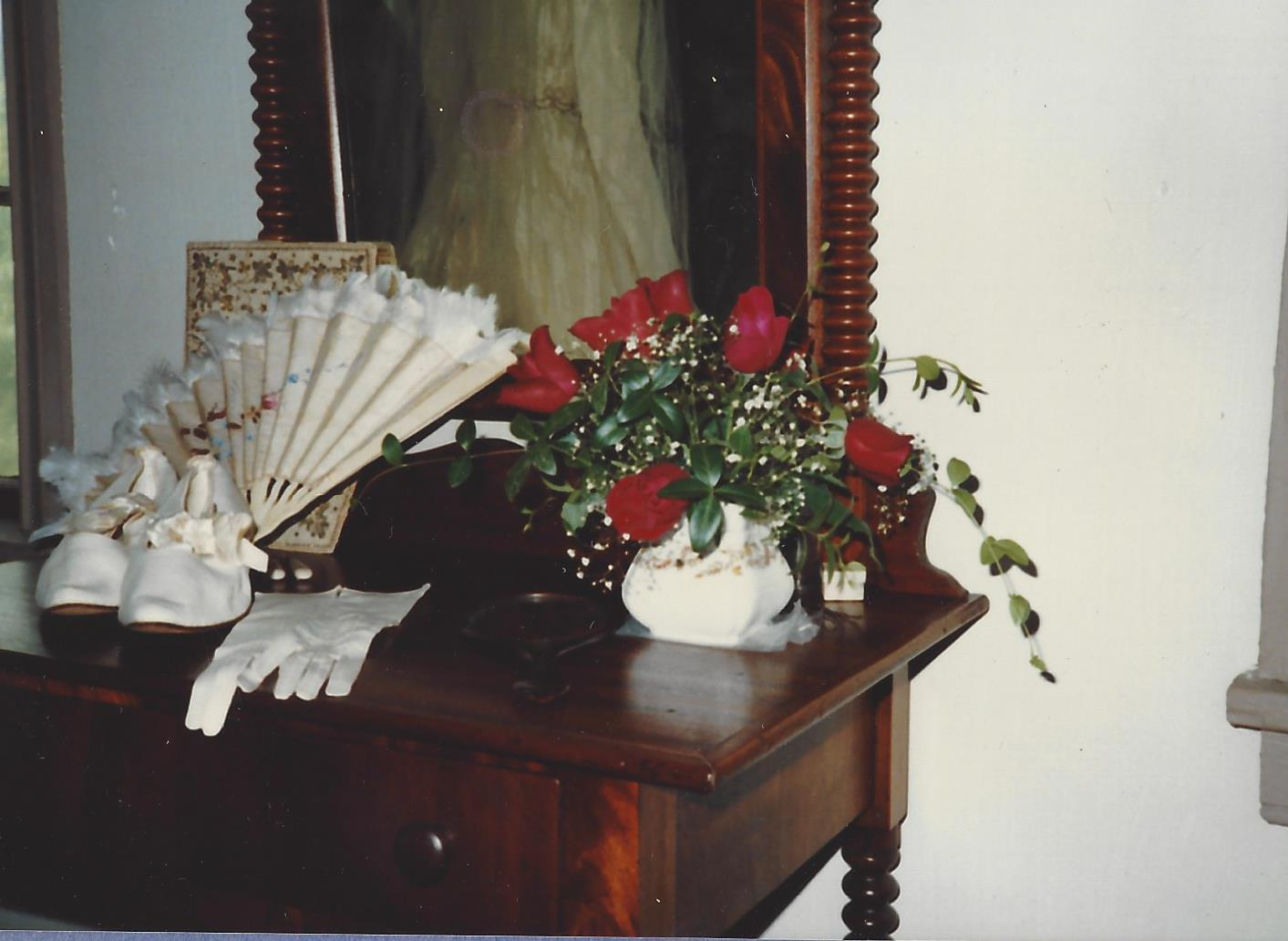
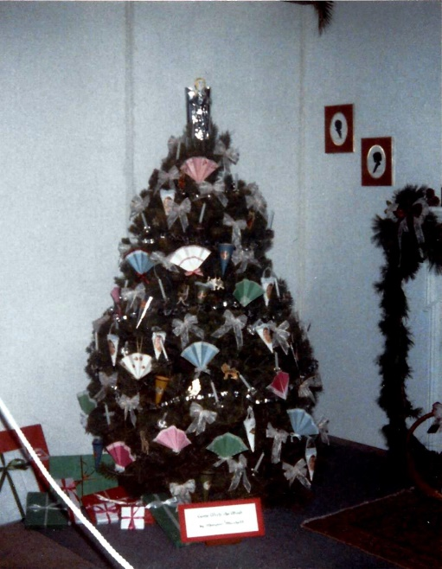
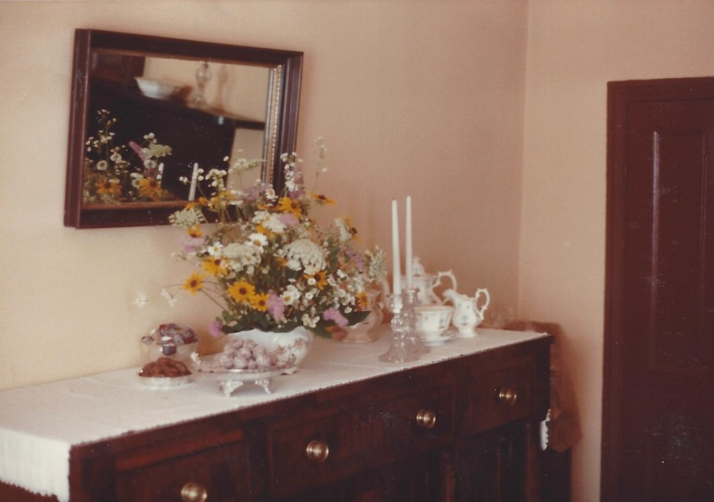
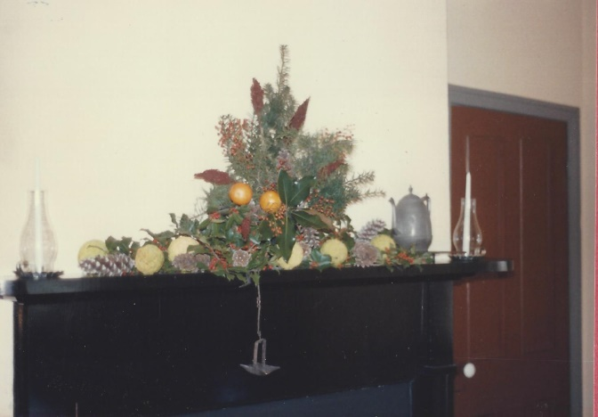
We volunteer
Providing Floral Arrangements for Victorian Wedding at Surratt House
Participated in Christmas Greens Exhibit 1982-1983 & 1985-1986
1986-1987
Surratt House Candlelight Tour Flower Arrangement
1983-1984
1982-1983

Slide 15
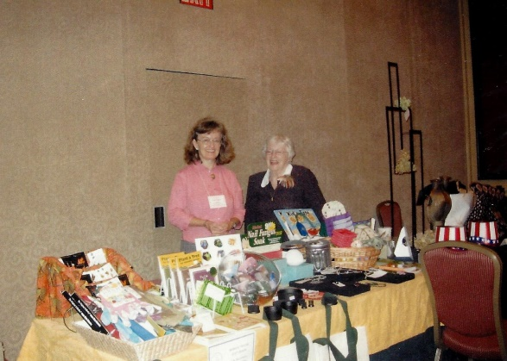
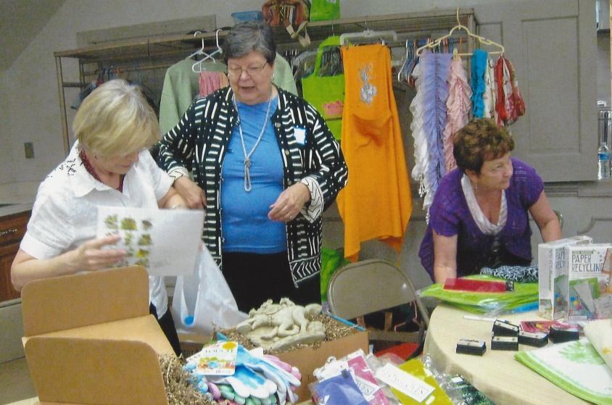
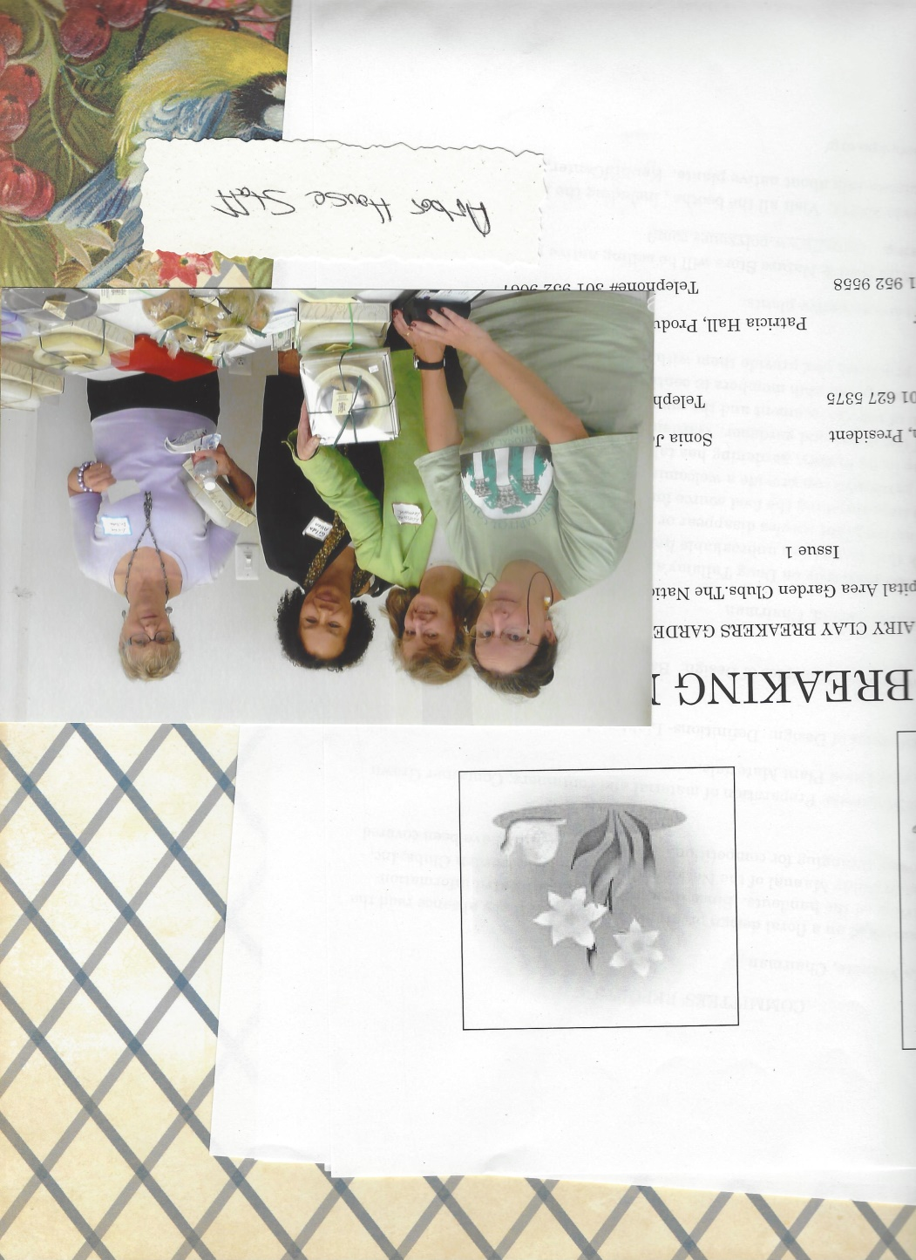
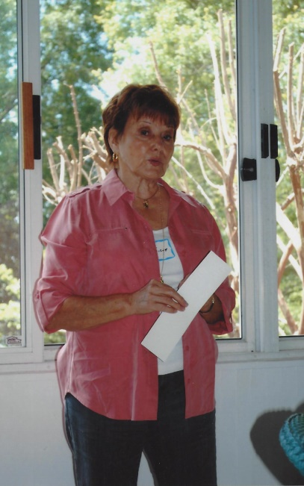
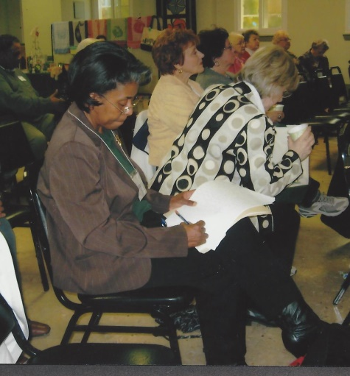
We volunteer
Lorraine Leonard & Anne DeBoeser
Arbor House table at CAR Convention
Mary Beth Cecil & Elaine Arnold
Design Table at
Arbor House Morning of Design
Casey, Lorraine Leonard, Gilda Allen & Linda Millette
Arbor House Sales Table
Julie Harrison
District 1 Director
Sonia Johnson
District 1 Recording Secretary

Slide 16
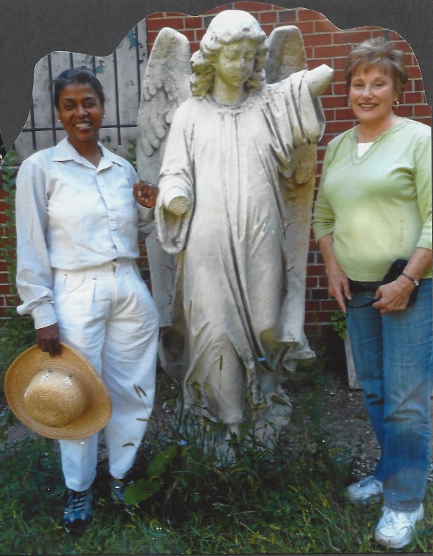
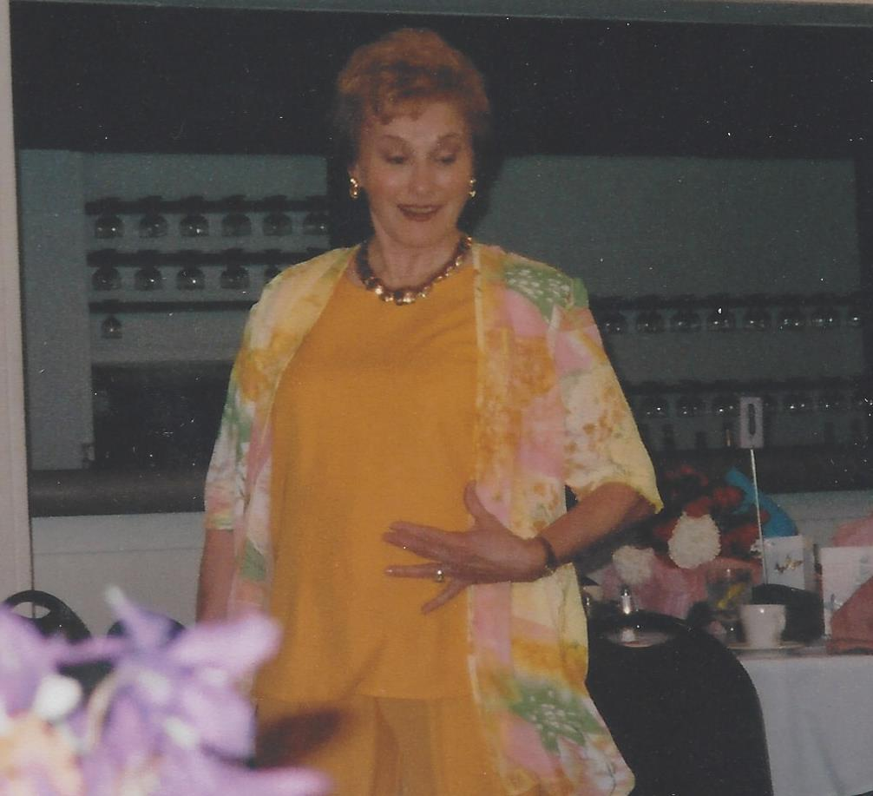
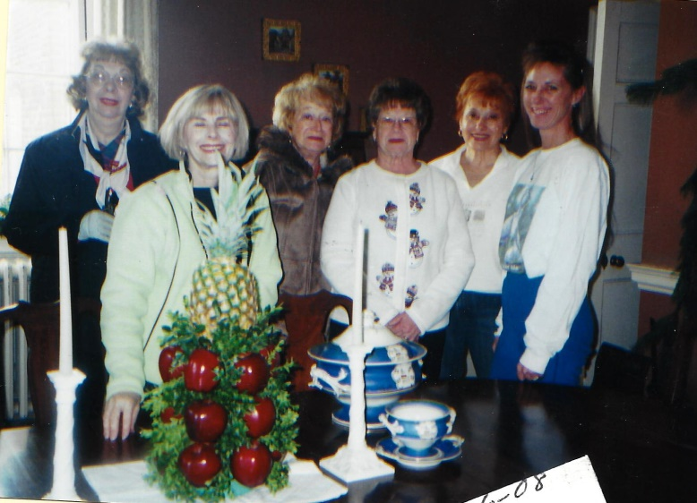
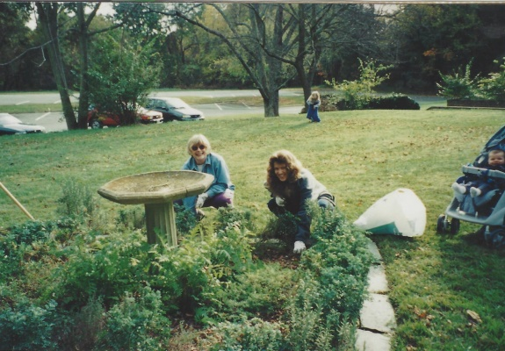
We volunteer
Julie Harrison
District 1 Fashion Show
Planting 32 trees at Memorial Grove Prospect Hill Cemetery
Herb Garden at Mt Airy Plantation
Decorating His Lordships Kindness for the holidays

Slide 17
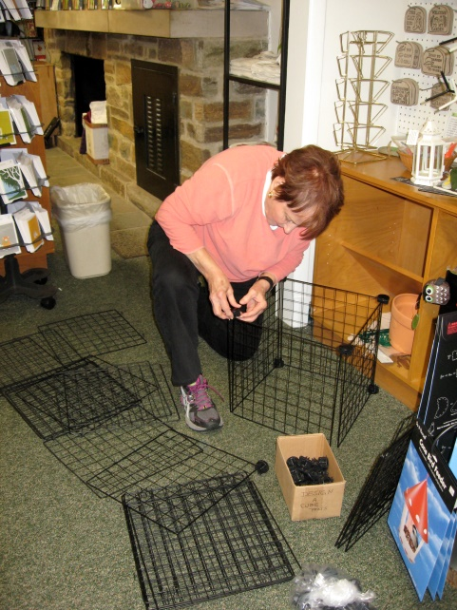
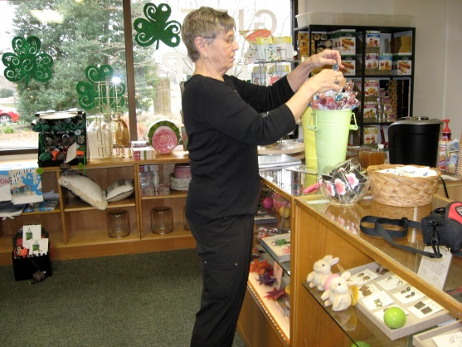
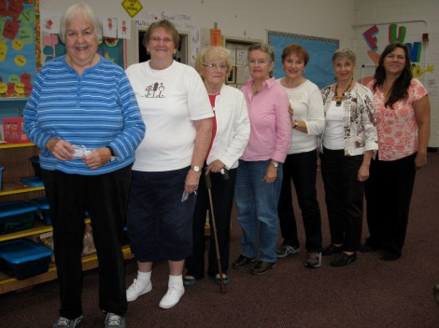
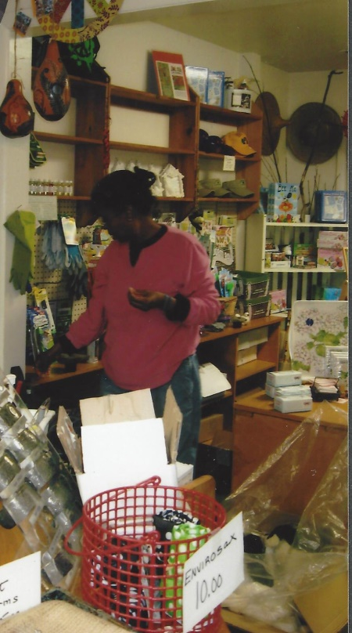
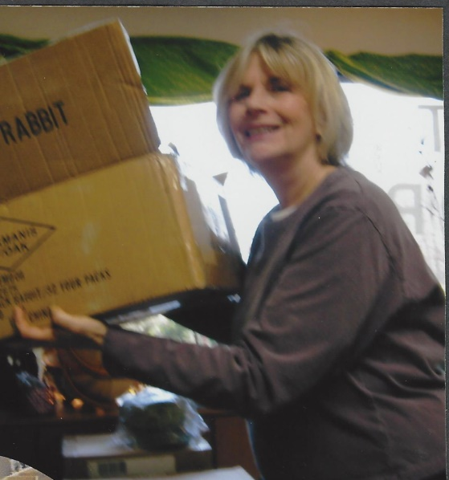
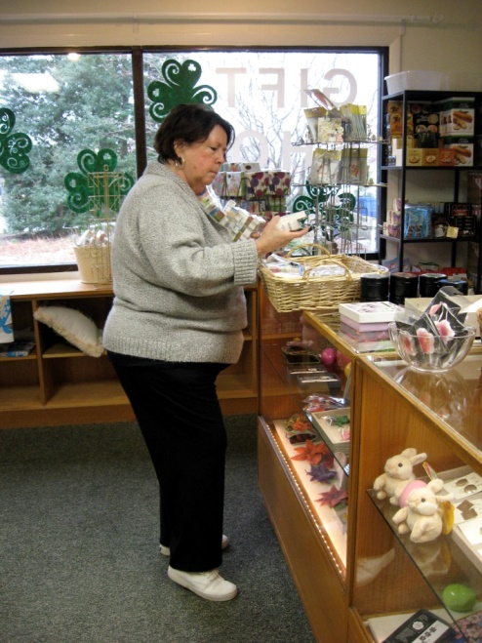
We volunteer
ARBOR HOUSE
Linda Millette
Julie Harrison
Mary Beth Cecil
Jackie George
Sonia Johnson

Slide 18





We volunteer
VETERANS NURSING HOME
2006-2007
2006-2007
2009-2010
2009-2010
2009-2010

Slide 19


We volunteer
TUNA CAN ARRANGEMENTS
BRADFORD OAKS NURSING HOME
2010-2011
2014-2015

Slide 20




We volunteer
NCAGC Project – Lots to shout about
Project leader linda millette 2013-2014
Deborah Determan
Lorraine Leonard
Anne DeBoeser
Julie Harrison

Slide 21

We participate in flower shows

Slide 22



We participate in flower shows
Hilltop garden club standard flower show
1978-1979
Our first time in a flower show
1983-1984
Peg Martin 2nd place

Slide 23







We participate in flower shows
Prince George’s County
1993-1994
Dottie Garrison
Blue Ribbon
The Early Years
2000-2001 Winners
2000-2001
Marian Moreland
preparing her entries
Liz Saniga 1st and Grand Prize
Liz Saniga
2nd place
Peg Martin
2nd place

Slide 24




We participate in flower shows
Prince George’s County
Lorraine Leonard’s 1st fair 2003-2004
Lorraine Leonard checking in
2016-2017
Linda Millette’s entry 2016-2017
Mary Jane Bishop won 2nd place 2003-2004

Slide 25






We participate in flower shows
1982-1983
Oxen Hill Manor
1984-1985
Potomac Chrysanthemum Society
Peg Martin Blue Ribbon
1983-1984
Potomac Lily Society
Anne DeBoeser
Blue Ribbon
1985-1986 Standard Flower Show

Slide 26




We participate in flower shows
1991-1992
Mini Flower Show
Presbyterian Church
1986-1987
Flower Show Exhibit by Pedal Pushers Junior Garden Club
1996-1997
Brunch for Flower Show
Jimmie Nell Finley & May Kemp
1996-1997
Flower Show

Slide 27


WE fundraise

Slide 28





WE fundraise
1979-1980
Surratt House Herb & Spice Weekend
1977-1978
Workshop for Craft Weekend at Surratt House
1991-1992
Fresh Arrangements and Bake Sale at Phyllis Tucker’s
1997-1998
Yard Sale with Plants and Baked Goods at
Holy Rosary Parking Lot
1998-1999
Yard and Plant Sale at Holy Rosary Parking Lot

Slide 29




WE fundraise
auctioneers
1995-1996
May Kemp
1984-1985
Marie White
1986-1987
Marie White
1997-1998
Esther Neckere

Slide 30




WE fundraise
Plant sales
2006-2007
Moravian Church
2004-2005
2005-2006
Moravian Church
2000-2001
at Mary Beth Cecil’s

Slide 31







WE fundraise
Plant sales

Slide 32






WE fundraise
St thomas church festival
2012-2017

Slide 33

WE fundraise
Pat Hall
50-50

