Slide 1



We receive recognition

Slide 2
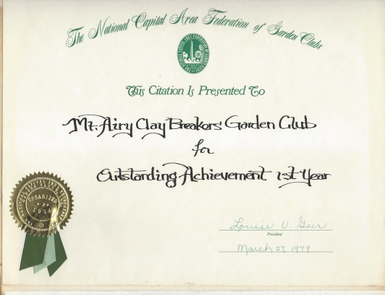
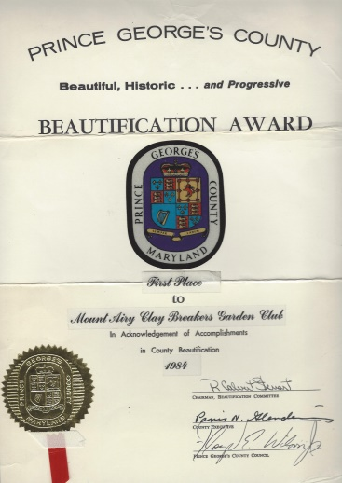
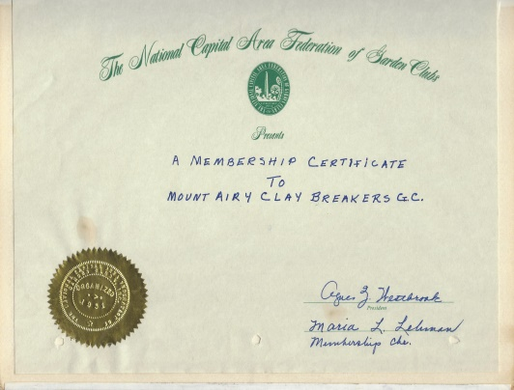
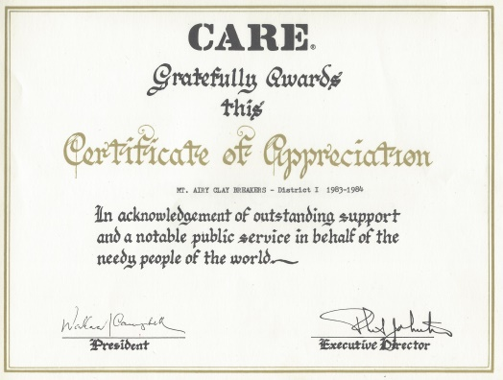
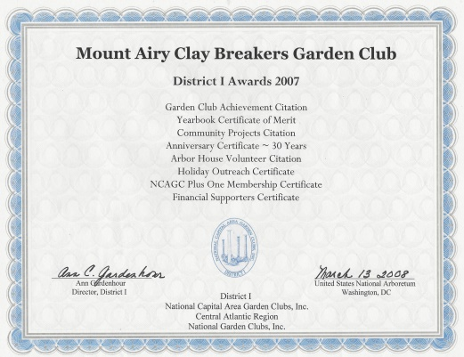
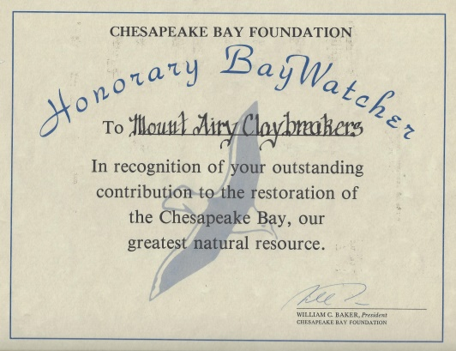
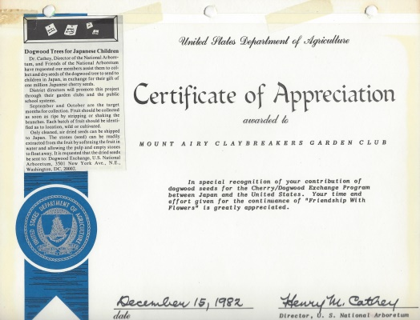
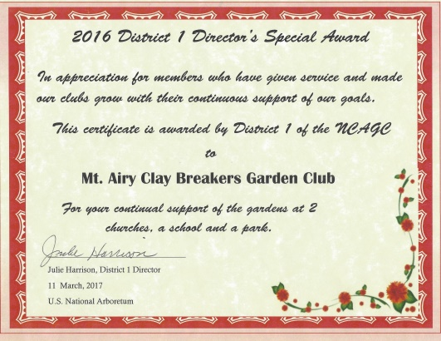
We receive recognition
** Certificates **
** Citations **
** Special Awards **
Examples from:
  NCAGC
  District 1
  CARE
  CAR
  Nursing Home
  District 1 Director
  NCAGC President
Note:
  We have 136 NCAGC Awards
  We have 112 District 1 Awards

Slide 3
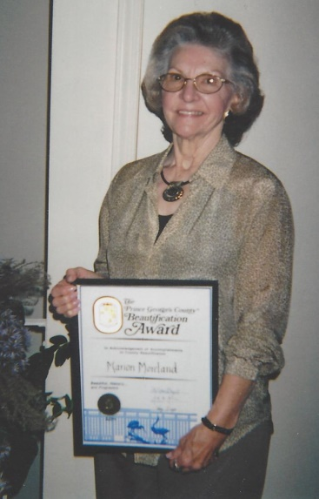
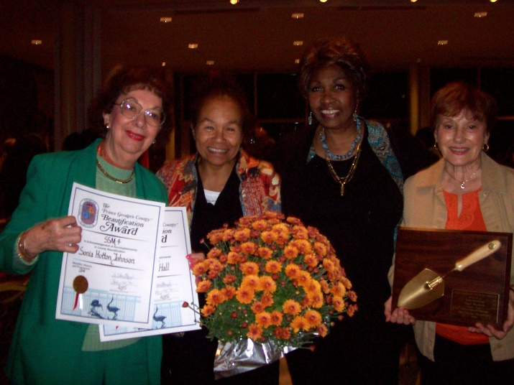
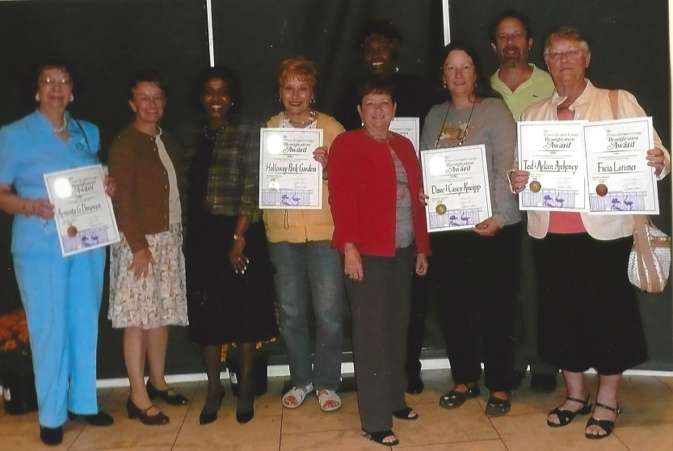
We receive recognition
PG County beautification awards

Slide 4
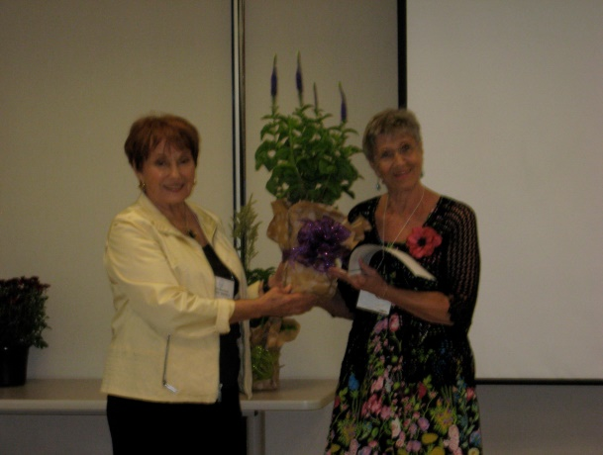
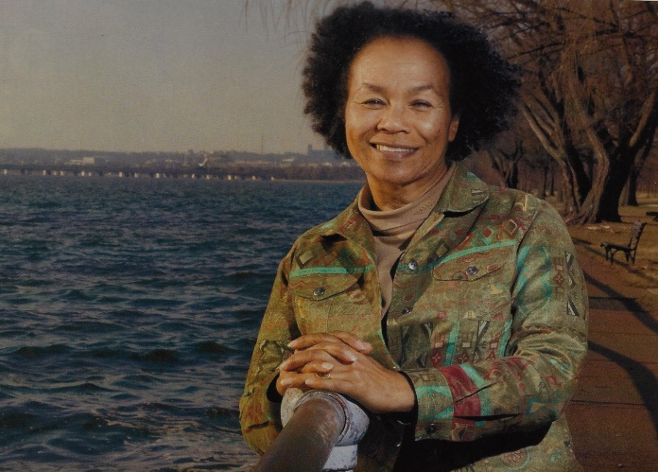
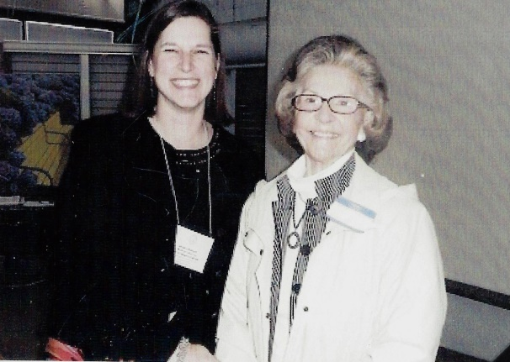
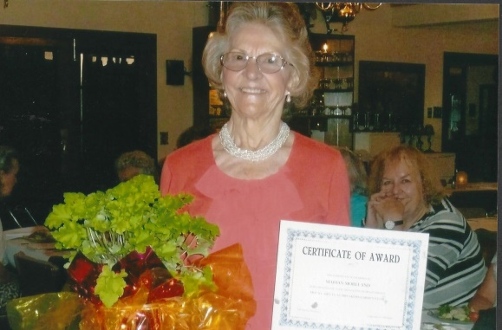
We receive recognition
Perennial Bloom Award
Linda Millette
Marian Moreland
Gilda Allen Green Award for
helping 30 schools set up their own conservation sites
Marian Moreland 25 Years of Service Award

Slide 5
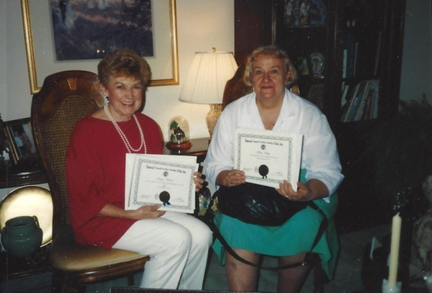
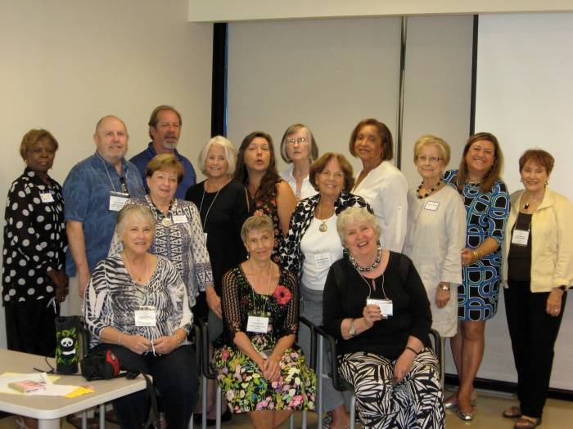
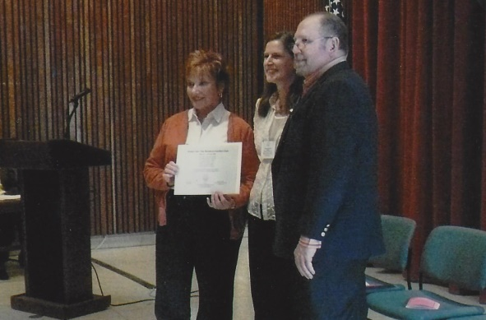
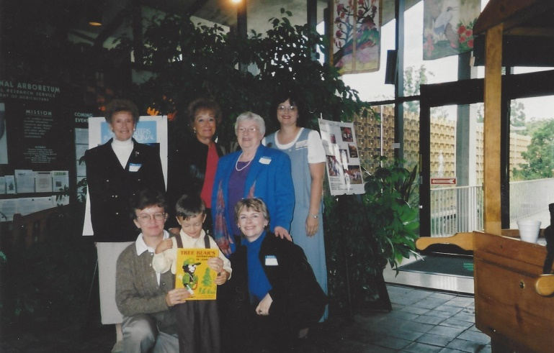
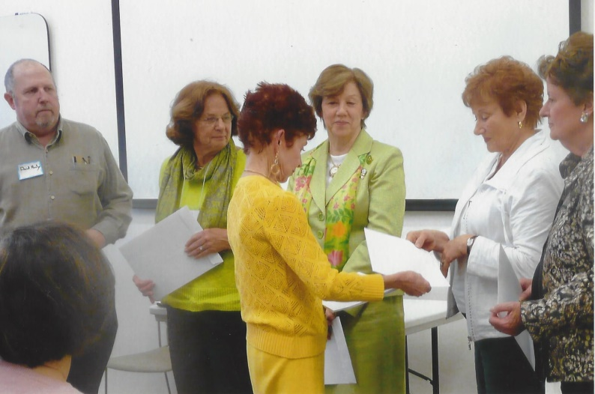
We receive recognition district 1 awards
Arbor House Volunteer Award
Peg Martin and Marie White
Julie Harrison accepting club awards
Thomas Leonard award for poetry
Julie Harrison accepting club awards

Slide 6
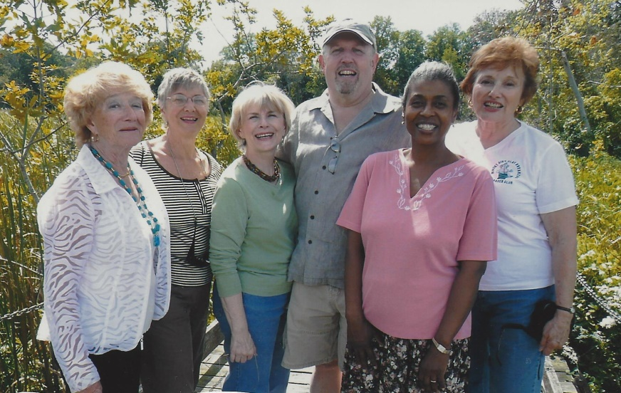
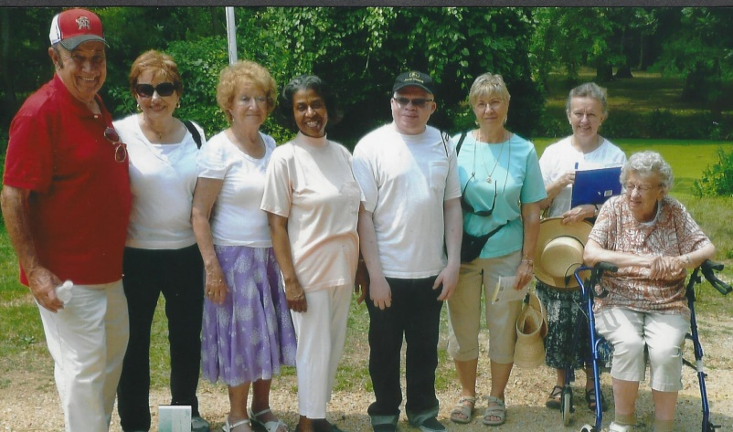
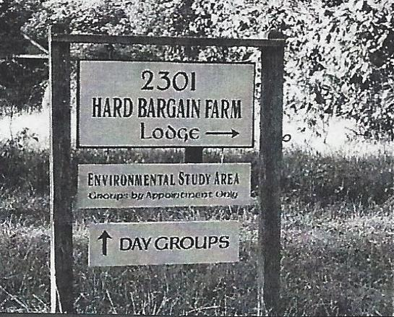
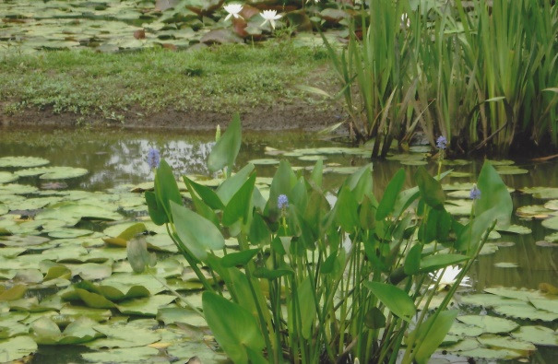
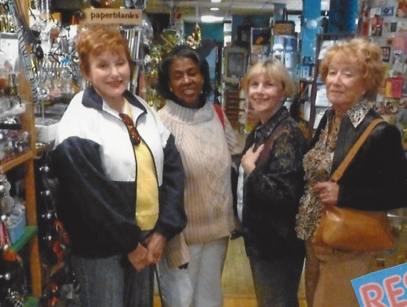
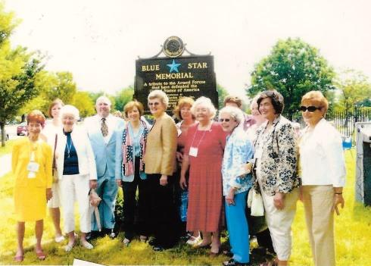
We are active in the District and the National Capital Area Garden Clubs
Meeting at Hard Bargain Farm
Presidents Meeting
Kenilworth Aquatic Gardens
NCAGC Blue Star Memorial Marker Dedication
Franklin Fund Raiser

Slide 7

We

Slide 8
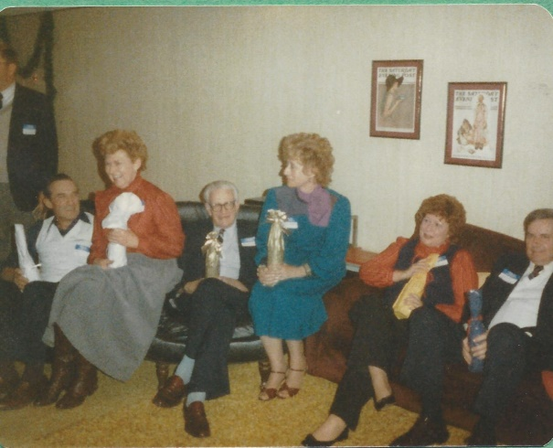
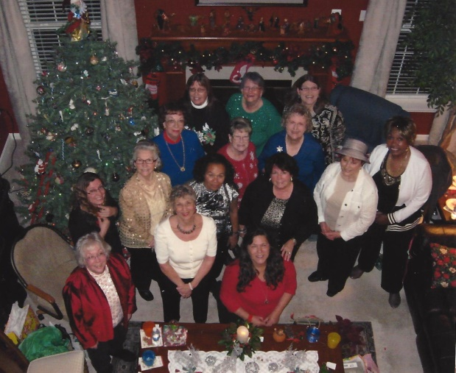
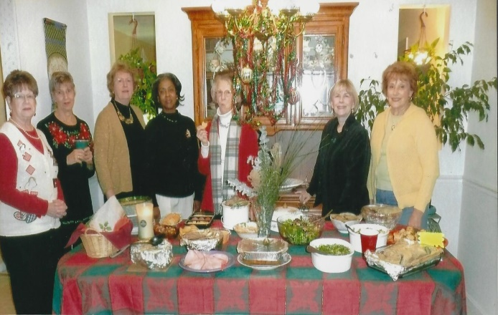
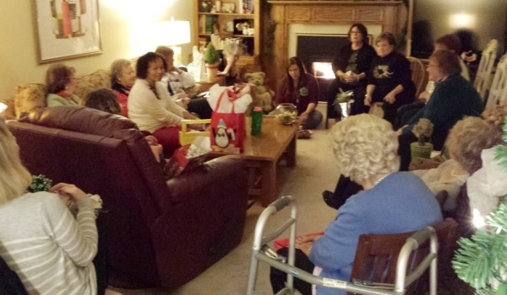
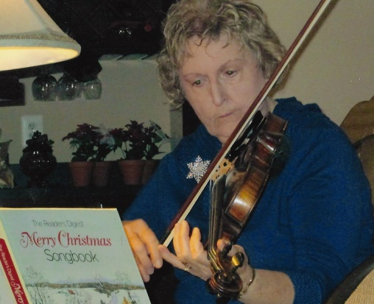
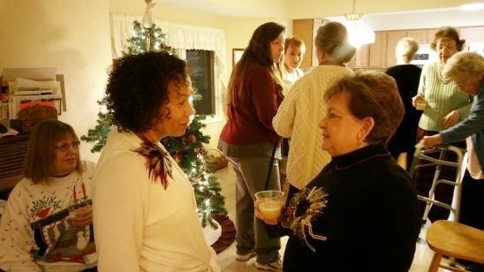
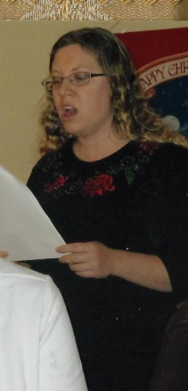
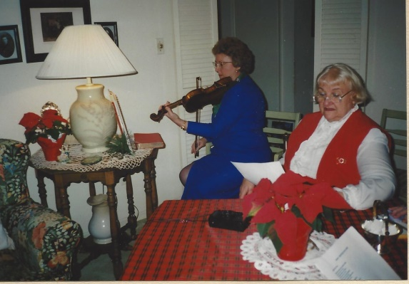
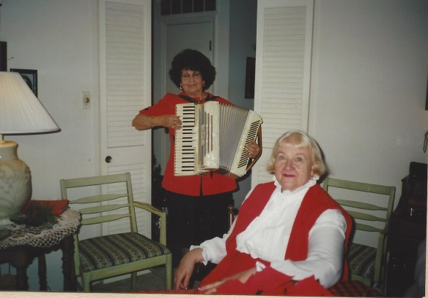
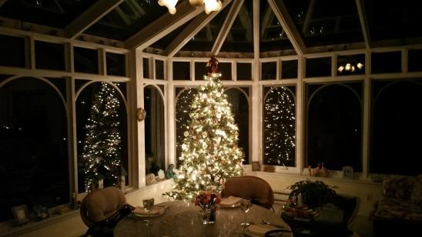
christmas
Why does everyone have a bottle of wine? (1984-1985)

Slide 9
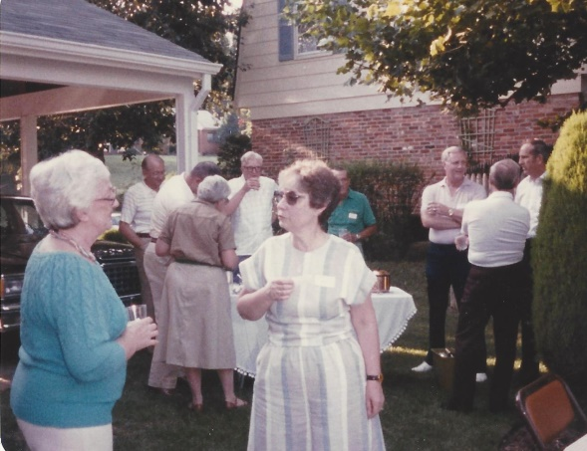
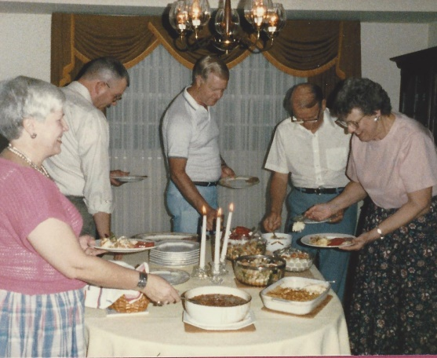
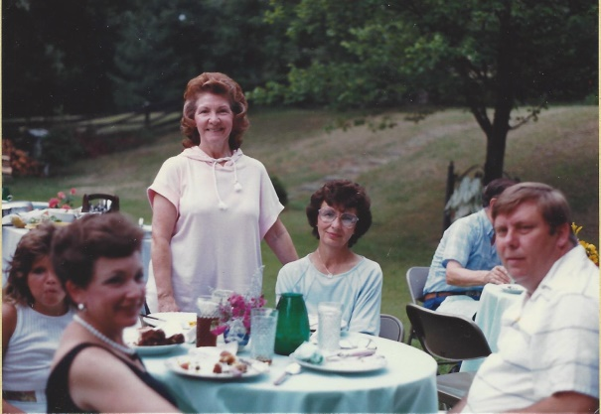
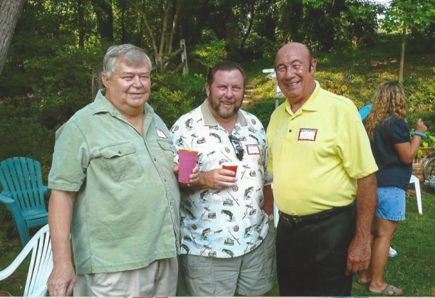
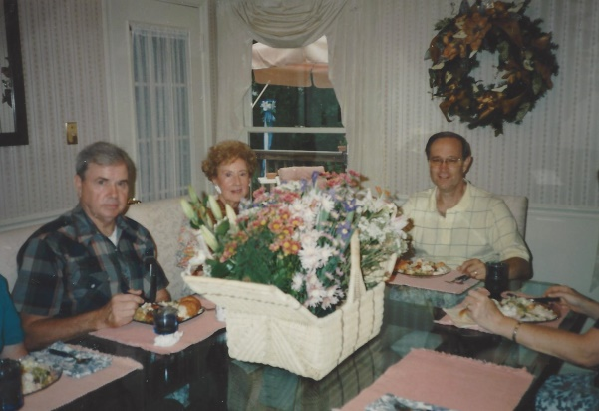
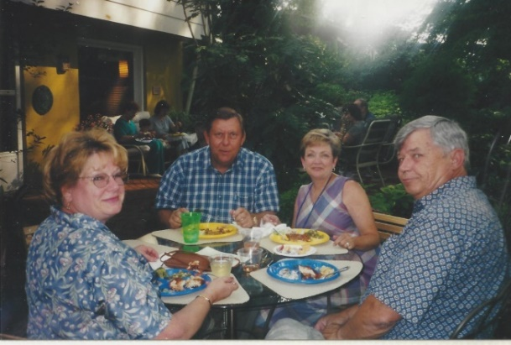
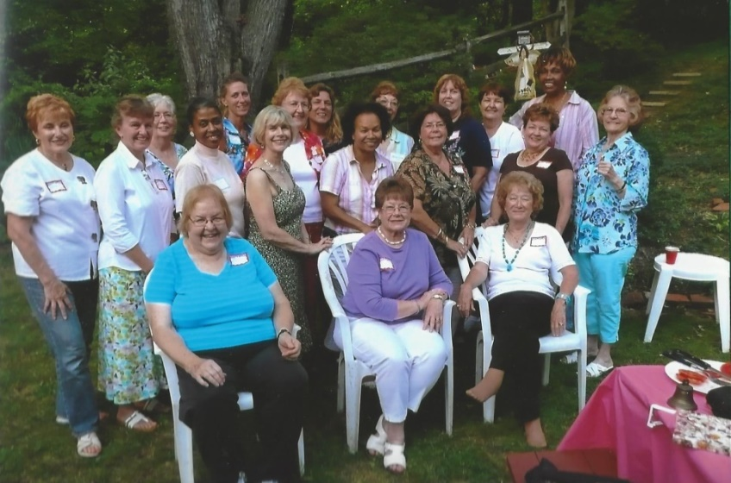
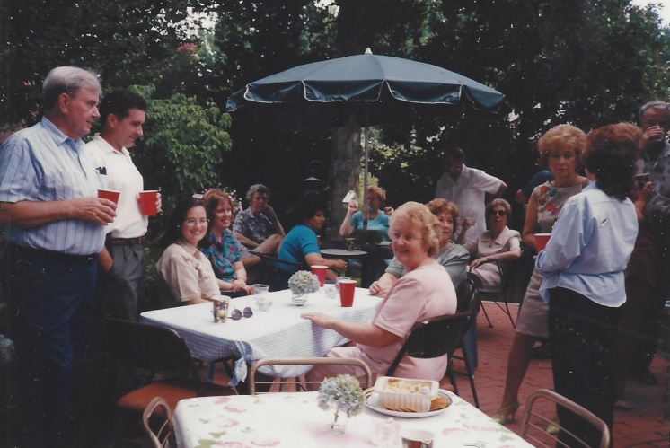
picnics

Slide 10
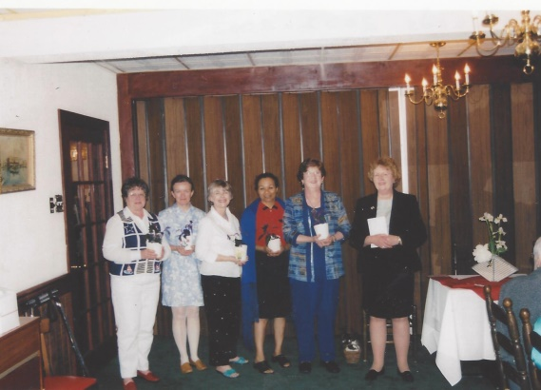
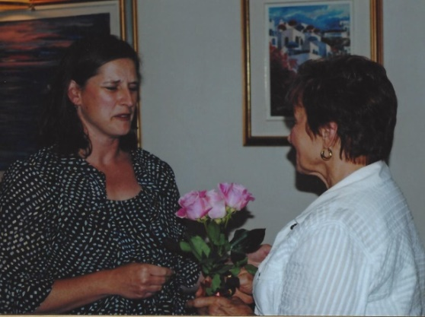
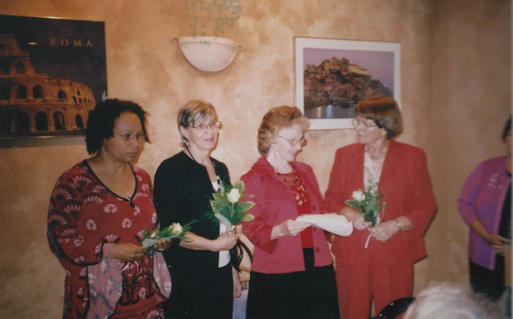
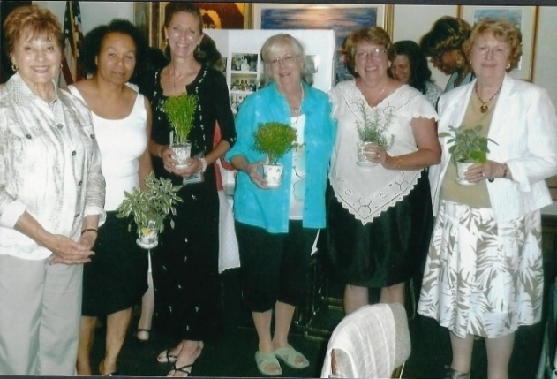
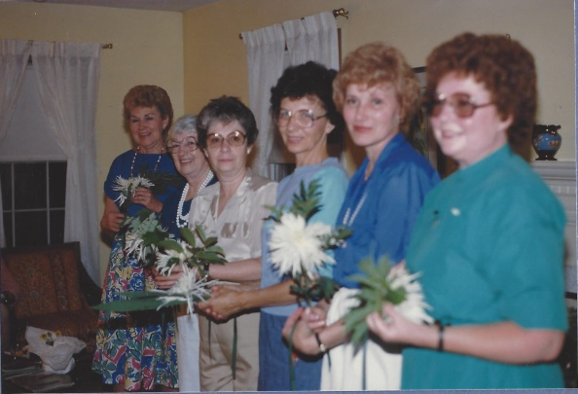
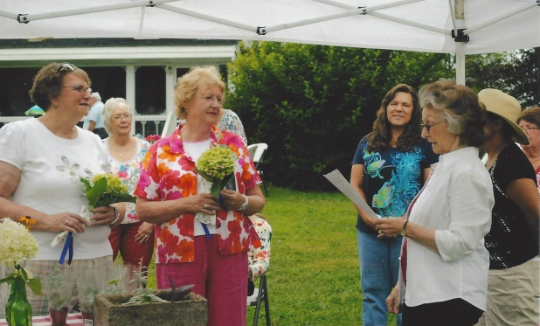



installations
installations

Slide 11











anniversaries
20th Anniversary at Springhouse April 1997
10th Anniversary
at Peg Martin’s 1986-1987
25th Anniversary at
Colony South 2001-2002
30th Anniversary at
Colony South 2006-2007

Slide 12








Presentation brought to you by:
Director and Researcher: Linda Millette
Research Assistants: Julie Harrison, Elaine Arnold, Lorraine Leonard, Joyce Meyer, Mary Beth Cecil
Media and Production Manager: Deborah Determan
Linda Millette
Elaine Arnold & Julie Harrison
Deborah Determan
See you in 10 years!!!
Julie Harrison
Elaine Arnold & Julie Harrison help organize scrapbooks
2013-2014

